Slide 1
NOCs: Past, Present and Future
Ahmed Hemani
Professor, Dept. Of Electronics, School of ICT, KTH, Stockholm Sweden
Email: hemani@kth.se

Slide 2
The Promise of NOC
Enable Billion Gate ASICs
Make them affordable

Slide 3

Exponentially Reduce the VLSI Design Space
Exponentially Reduced Design Space
Design Space Exploration
System
Automation
Higher Impact Design Space
Rapid
Post Layout Accuracy
Application
Algoritims
RTL Physical Design Platform
Abstraction Level
RTL /
μ-architecture
Auotmated
One Time
Synchoros VLSI Design
Synchoros VLSI Design
Boolean Level Physical Design Platform
NOCs / CGRAs
NOCs / CGRAs
Gates
Physical/Rectangles
# of Solutions increases exponentially with abstraction gap
Notes:
We propose to raise the abstraction of physical design platform to RTL with the help of NOCs and CGRAs on one hand and synchoricity on the other. I will introduce the concept of synchoricity in the next slide.
By raising the abstraction of physical design to RTL

Slide 4
Synchronicity
Synchoricity
Syn + Choros (space in Greek)
Time is discretized uniformly
using clock ticks
Space is discretized uniformly
using a virtual grid
D
Q
D
Q
clk₁
clk₂
Can be spatially composed If
If the number of grid cells
in each dimension are equal
&
Their interconnect edges are abuttable
Can be temporally composed If
clk₁ = clk₂
&
The two clocks are skew aligned

Slide 5

SiLago Blocks → μ-architecture Level Physical Design SiLago: Silicon Large Grain Object
Micro-architecture level CGRA Cells
3-4 orders larger than Standard Cells
All Interconnects
At right place
On Right Metal Layer
Composition by abutment
SiLago
Block
Hardened &
Characterized with
Post Layout Data
All Global Wires (Clock, Power, NOC)
Absorbed within the hardened SiLago Blocks
Notes:
So what do we mean by sychoros VLSI Design Style
As already state synchoricity means discretizing the space uniformly with the help of grid the clock ticks help enforcre synchronicity

Slide 6
Composition by Abutment
Regional / Local NOCs
dout
din
dout
din
dout
din
Without NOCs and Synchoricity
The compostion by abutment scheme
Would be impractical
This policy is applied to
Clock, Reset and Power Grid as well
dout
din
dout
din
dout
din
dout
din
dout
din
dout
din

Slide 7
NOC/CGRAs + Synchoricity Enables Composition By Abutment
No further VLSI Engineering Needed

Slide 8
SiLago Design Instances = Σ Region Instances
Protocol Processing Region
Interrupt Ctrl
Distributed Memory Architecture
DiMArch
PLL/CGU
PMC
NOCs
Ethernet
NOC Switch
SiLago Blocks
Region Specific Network Interface Units
Data
Memory
Buffered/Pipelined
NOC SiLago Blocks
DiMArch
DiMArch
NOCs
System
Controller
Dynamically Reconfigurable
Resource Array
DRRA
Program
Memory
TSVs
Conceptual
Does Not Exist
3D Memory Control

Slide 9
NOCs are key enablers of Composition by Abutment for DSE
SiLago Design Space: Exponentially Reduced
SiLago Physical Design Platform
System
Automation
Design Space Exploration
VLSI Designs
Composition By Abutment
Application
Design
Instance 1
Design
Instance 2
. . .
Algoritims
SiLago Physical Design Platform
Abstraction Level
RTL /
μ-architecture
Synchoros VLSI Design
NOCs / CGRAs
Gates
Physical/Rectangles
# of Solutions increases exponentially with abstraction gap

Slide 10
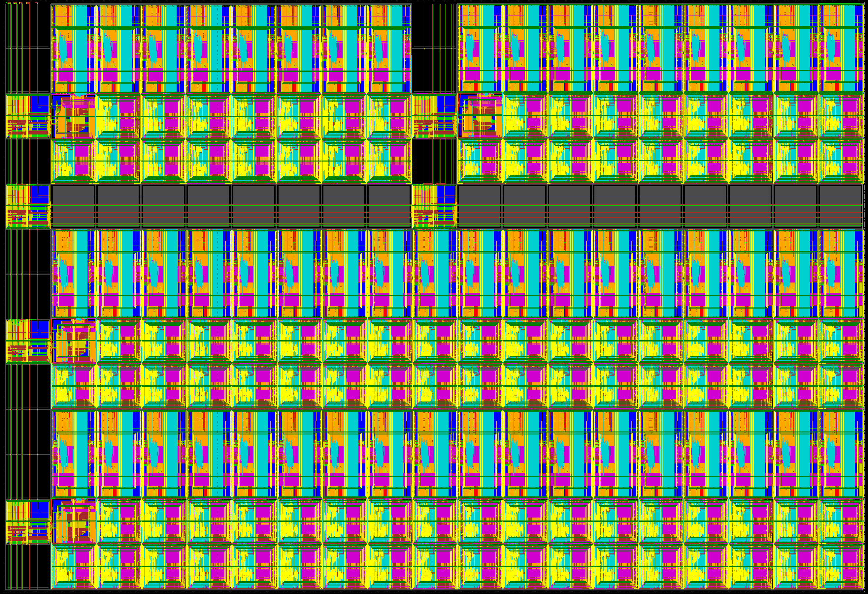
SiLago
Physical Design Platform
VLSI Designs
Composition By Abutment
Design
Instance 1
Design
Instance 2
One VLSI Design Instance generated by Abutting SiLago Blocks

Slide 11
NOCs are multi-layer clustering agents for DSE
LSTM Model in MATLAB
SiLago Design Space: Exponentially Reduced
SiLago Physical Design Platform
System
Automation
Design Space Exploration
VLSI Designs
Composition By Abutment
Application
Design
Instance 1
Design
Instance 2
. . .
Algoritims
SiLago Physical Design Platform
Abstraction Level
RTL /
μ-architecture
Coarse Grain
Reconfiguration
Synchoros VLSI Design
NOCs / CGRAs
Gates
Implementation
Alternative 1
Implementation
Alternative 2
. . .
Physical/Rectangles
O(10⁴³) options
# of Solutions increases exponentially with abstraction gap

Slide 12
SiLago vs. Standard Cell Based ASIC Design Flow
Normalized Energy and Area overhead of the Systems
generated by the SiLago Design Flow
2.0
Area
Coarse Grain Reconfigurability Becomes an Advantage
1.8
Energy
1.6
1.4
1.2
1.0
0.8
30-50% Area Overhead
10-30% Energy Overhead
In some cases SiLago beats ASIC in energy
0.6
0.4
0.2
0
Jpeg
Encoder
WLAN
Tx
LTE
Uplink
CNN
Face
Recognition
Multi-mode Accelerator

Slide 13

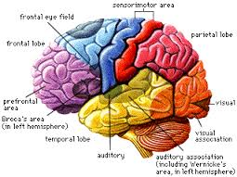
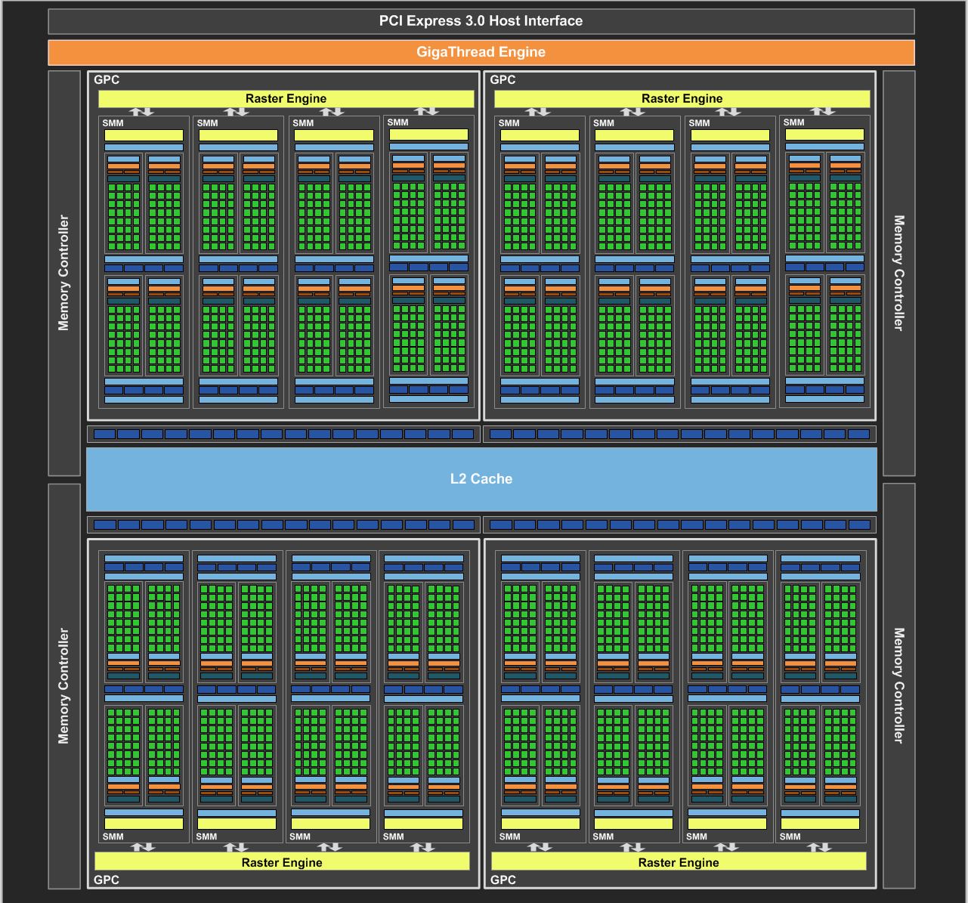
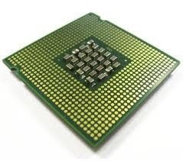

SiLago Enables Automation of Highly Efficient Custom Design
Biological Plausible Model of Cortex: ~1 PetaFlops,
40 TBs Synaptic Weights at 140 TBs/s bandwidth
eBrain II@KTH
20 Watts
3 MW
3 kW
SiLago
Enables design automation of such high performance custom computing machines
GPUs
~30 MilliWatts
14 kW
12 Watts

Slide 14


The Impact
1000 X
1000 X
Software Centric / GPU + Processor
Based Designs
Hardware Centric
SiLago Based Designs

