Slide 1
A Multi-Vdd Dynamic Variable-Pipeline On-Chip Router for CMPs
Hiroki Matsutani
Yuto Hirata
Michihiro Koibuchi
Kimiyoshi Usami
Hiroshi Nakamura
Hideharu Amano
(Keio Univ, Japan)
(Keio Univ, Japan)
(NII, Japan)
(Shibaura IT, Japan)
(Univ Tokyo, Japan)
(Keio Univ, Japan)

Slide 2
Multi-core & many-core
picoChip PC102
picoChip PC205
256
ClearSpeed CSX700
128
ClearSpeed CSX600
Intel 80-core
64
TILERA TILE64
32
Intel SCC
Number of PEs (caches are not included)
MIT RAW
UT TRIPS (OPN)
Target
16
STI Cell BE
Chip multi-
processor (CMP)
8
Sun T1
Sun T2
Fujitsu SPARC64
4
Intel Core, IBM Power7
AMD Opteron
2
2004
2006
2008
2010
2011

Slide 3
Our target: NoC for future CMPs
16-tile CMP example
Each tile consists of processor, L1, and L2 cache bank
L2 banks form a single shared L2 cache → SNUCA
UltraSPARC
L1 cache (I & D)
L2 cache bank

Slide 4
Our target: NoC for future CMPs
16-tile CMP example
Each tile consists of processor, L1, and L2 cache bank
L2 banks form a single shared L2 cache → SNUCA
Tiles are interconnected via Network-on-Chip (NoC)
UltraSPARC
L1 cache (I & D)
L2 cache bank
On-chip router
A DVFS-like technique of on-chip routers for low-power CMPs

Slide 5
Problem: DVFS for on-chip routers
If DVFS is applied to on-chip routers…
Each router works at different frequency
How to communicate between different frequency domains?
333MHz
400MHz

Slide 6
Problem: DVFS for on-chip routers
If DVFS is applied to on-chip routers…
Each router works at different frequency
How to communicate between different frequency domains?
333MHz
400MHz
Possible solutions
1. Frequency of a router is restricted to integer multiple of adjacent one
E.g., 300MHz vs. 150MHz
2. Asynchronous communication protocol
Versatile but too costly
Any other solution? – Multi-Vdd variable-pipeline router !

Slide 7
Multi-Vdd variable-pipeline router
Existing DVFS router
Voltage and frequency are adjusted
Multi-Vdd variable-pipeline router
Voltage and “router pipeline depth” are adjusted
All routers work at the same frequency
Communication between different frequency domains introduces some difficulties…
Vdd and pipeline-mode switching policies
Low workload: 2-cycle mode @ Vdd-low
High workload: 1-cycle mode @ Vdd-high
Low temperature: 1-cycle mode @ Vdd-high
High temperature: 2-cycle mode @ Vdd-high

Slide 8
Outline: Multi-Vdd variable-pipeline router
Problem of DVFS router
Each router works at different frequency
Communication between different frequency domains
Multi-Vdd variable-pipeline router
Voltage and “router pipeline depth” are adjusted
All routers work at the same frequency
Voltage switch policies:
Low-power policy
Delay variation tolerance using a thermal sensor
Evaluations
Circuit-level evaluations
System-level evaluations

Slide 9
Original router: Overview & pipeline
Routing comp (RC)
Arbitration (VSA)
Switch traversal (ST)
Link traversal (LT)
Arbiter
X+
FIFO
X+
X-
FIFO
X-
Y+
FIFO
Y+
Y-
FIFO
Y-
5x5
Crossbar SW
Core
Core
FIFO

Slide 10
Multi-Vdd variable-pipeline router
Vdd-high
Vdd-low
Vdd select
Voltage switch
Pipeline control
Arbiter
X+
FIFO
X+
X-
FIFO
X-
Y+
FIFO
Y+
Y-
FIFO
Y-
5x5
Crossbar SW
Core
Core
FIFO

Slide 11
Multi-Vdd variable-pipeline router
Vdd-high
Vdd-low
Vdd select
Voltage switch
Pipeline control
Level shifter
Arbiter
X+
FIFO
X+
X-
FIFO
X-
Y+
FIFO
Y+
Y-
FIFO
Y-
5x5
Crossbar SW
Core
Core
FIFO

Slide 12
Multi-Vdd variable-pipeline router
Vdd-high
Vdd-low
Vdd select
Output buffer bypassing
Voltage switch
Pipeline control
Level shifter
Arbiter
X+
FIFO
X+
X-
FIFO
X-
Y+
FIFO
Y+
Y-
FIFO
Y-
5x5
Crossbar SW
Core
Core
FIFO
Enabling/disabling output buf changes the router pipeline mode

Slide 13
Variable-pipeline: Three modes
All routers work at the same frequency
2-cycle mode
Output buf is enabled
Low performance (2-cycle per hop)
Short critical path
Vdd-low (low-power)
1-cycle mode
Output buf is bypassed
High performance (1-cycle per hop)
Long critical path
Vdd-high (high-power)
@Router 1
@Router 2
@Router 1
@Router 2
RC/
VSA
RC/
VSA
RC/
VSA
RC/
VSA
ST
LT
ST
LT
ST,LT
ST,LT

Slide 14
Variable-pipeline: Three modes
All routers work at the same frequency
3-cycle mode
Adaptive routing is available
More communication latency (3-cycle per hop)
Hotspots and faulty routers can be dynamically avoided
@Router 1
@Router 2
RC
VSA
ST
LT
RC
VSA
ST
LT
4x4 NoC (one hotspot)
3-cycle mode is useful for hotspot traffic or fault tolerance

Slide 15
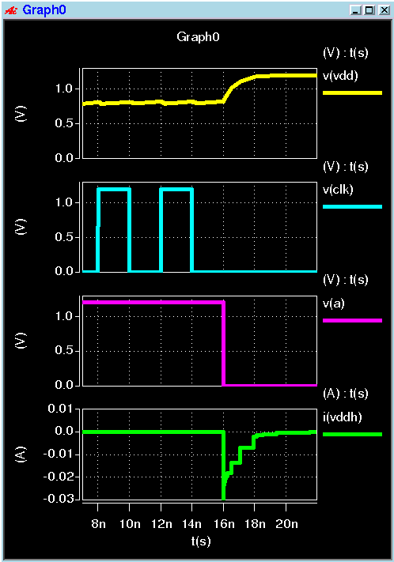
Variable-pipeline router: Design
Standard cells
Fujitsu 65nm library
Custom cells (level shifter, voltage switch)
Synthesis
Synopsys Design Compiler
Place and route
Synopsys Astro
RC extraction
Cadence QRC
SPICE simulation
Synopsys HSIM
VDD
Vdd-low
Vdd-high
Clock
Clock is stopped
to clearly show energy
Select
Voltage switch
Current
Fujitsu 65nm (0.8V→1.2V, 25C)

Slide 16
Variable-pipeline: Freq & Vdd levels
All routers work at 392.2MHz
2-cycle mode
Output buf is enabled
Low performance (2-cycle per hop)
Delay: 1831psec @ 1.2V
Vdd-low: 0.83V
1-cycle mode
Output buf is bypassed
High performance (1-cycle per hop)
Delay: 2550psec @ 1.2V
Vdd-high: 1.20V
@Router 1
@Router 2
@Router 1
@Router 2
RC/
VSA
RC/
VSA
RC/
VSA
RC/
VSA
ST
LT
ST
LT
ST,LT
ST,LT
All routers work at 392.2MHz; 1-cycle@1.2V; 2-cycle@0.83V

Slide 17
Outline: Multi-Vdd variable-pipeline router
Problem of DVFS router
Each router works at different frequency
Communication between different frequency domains
Multi-Vdd variable-pipeline router
Voltage and “router pipeline depth” are adjusted
All routers work at the same frequency
Voltage switch policies:
Low-power policy
Delay variation tolerance using a thermal sensor
Evaluations
Circuit-level evaluations
System-level evaluations

Slide 18
Policy 1: Standby-power reduction
Each router
Notifies the packet arrival to 2-hop away
Can detect next packet arrival 2-hop earlier
Packet arrival detected:
2-cycle to 1-cycle (boost)
Raise the voltage
Reduce pipeline stage
After packet transfer:
1-cycle to 2-cycle (relax)
Increase pipeline stage
Reduce the voltage
Vdd transition: 2 cycle
Only 1st hop cannot detect packet arrival in advance.
2-cycle transfer at 1st hop
Vdd up
2cycle

Slide 19
Policy 1: Standby-power reduction
Each router
Notifies the packet arrival to 2-hop away
Can detect next packet arrival 2-hop earlier
Packet arrival detected:
2-cycle to 1-cycle (boost)
Raise the voltage
Reduce pipeline stage
After packet transfer:
1-cycle to 2-cycle (relax)
Increase pipeline stage
Reduce the voltage
Vdd transition: 2 cycle
Only 1st hop cannot detect packet arrival in advance.
2-cycle transfer at 1st hop
Vdd up
2cycle
1cycle

Slide 20
Policy 1: Standby-power reduction
Each router
Notifies the packet arrival to 2-hop away
Can detect next packet arrival 2-hop earlier
Packet arrival detected:
2-cycle to 1-cycle (boost)
Raise the voltage
Reduce pipeline stage
After packet transfer:
1-cycle to 2-cycle (relax)
Increase pipeline stage
Reduce the voltage
Vdd transition: 2 cycle
Only 1st hop cannot detect packet arrival in advance.
2-cycle transfer at 1st hop
Vdd up
2cycle
1cycle
1cycle

Slide 21
Policy 1: Standby-power reduction
Each router
Notifies the packet arrival to 2-hop away
Can detect next packet arrival 2-hop earlier
Packet arrival detected:
2-cycle to 1-cycle (boost)
Raise the voltage
Reduce pipeline stage
After packet transfer:
1-cycle to 2-cycle (relax)
Increase pipeline stage
Reduce the voltage
Vdd transition: 2 cycle
Only 1st hop cannot detect packet arrival in advance.
2-cycle transfer at 1st hop
2cycle
1cycle
1cycle
1cycle
Vdd-low when no packet; 1-cycle@Vdd-high when packets come

Slide 22
Policy 2: Delay variation tolerance
Each router has
A thermal sensor to detect the delay change
Routers temp. will change depending on adjacent CPUs
Normal temperature
(1-cycle@Vdd-high)
High temperature
(2-cycle@Vdd-high)

Slide 23
Policy 2: Delay variation tolerance
Each router has
A thermal sensor to detect the delay change
Delay margin decreases:
More margin is needed
1-cycle @ Vdd-high → 2-cycle @ Vdd-high
Delay margin increases:
Margin can be relaxed
2-cycle @ Vdd-high → 1-cycle @ Vdd-high
Routers temp. will change depending on adjacent CPUs
Normal temperature
(1-cycle@Vdd-high)
High temperature
(2-cycle@Vdd-high)

Slide 24
Outline: Multi-Vdd variable-pipeline router
Problem of DVFS router
Each router works at different frequency
Communication between different frequency domains
Multi-Vdd variable-pipeline router
Voltage and “router pipeline depth” are adjusted
All routers work at the same frequency
Voltage switch policies:
Low-power policy
Delay variation tolerance using a thermal sensor
Evaluations
Circuit-level (area, switching latency & energy, BET)
System-level (application performance, standby power)

Slide 25
Evaluation: Area overhead
Vdd-high
Vdd-low
Vdd select
Output buffer bypassing
Voltage switch
Pipeline control
Level shifter
Arbiter
X+
FIFO
X+
X-
FIFO
X-

Slide 26
Evaluation: Area overhead
Hardware amount of original and variable-pipeline routers [kilo gates]
 | Router | Level shifter | Voltage switch | Total
Original | 59.41 | 0 | 0 | 59.41
Proposed | 63.13 (*) | 4.11 | 0.54 | 67.78 (+14.1%)
(*) Thermal sensor is not included
Vdd-high
Vdd-low
Vdd select
Output buffer bypassing
Voltage switch
Pipeline control
Level shifter
Arbiter
X+
FIFO
X+
X-
FIFO
X-

Slide 27
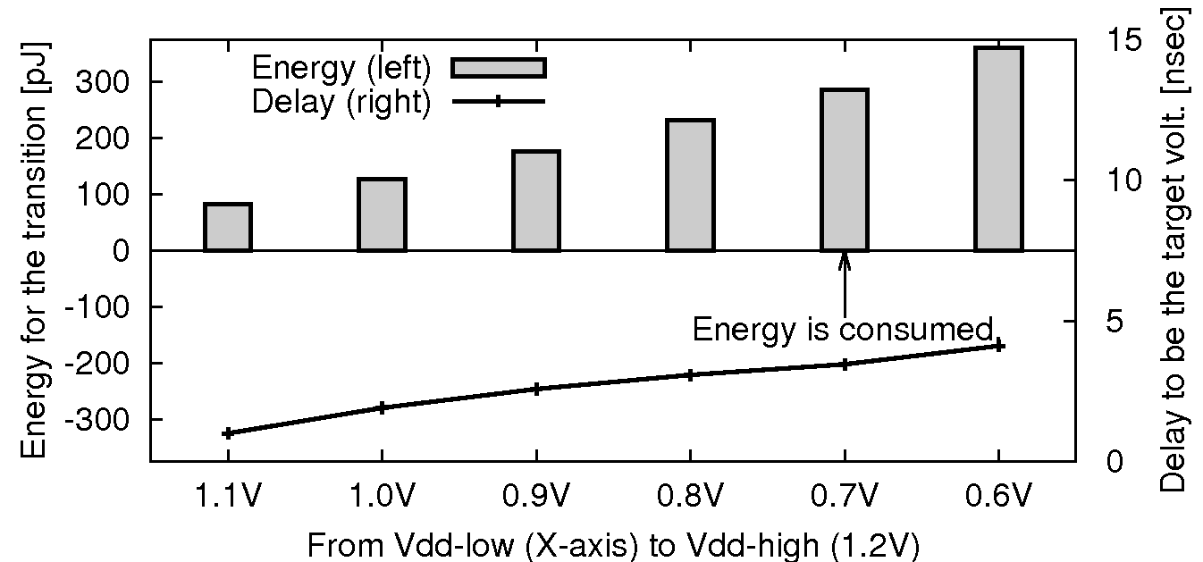
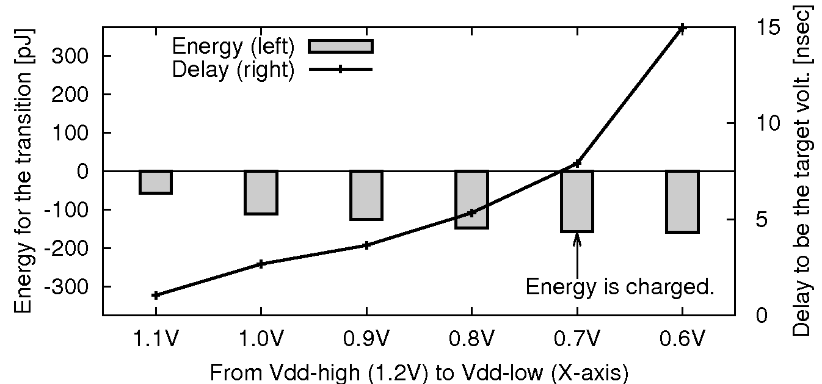
Evaluation: Transition time & energy
Vdd-high is 1.2V; Vdd-low ranges 0.6V-1.1V
Low to high transition
E.g., 0.8V to 1.2V
Transition time: 3.1nsec
231 pJ is consumed
High to low transition
E.g., 1.2V to 0.8V
Transition time: 5.3nsec
148 pJ is charged
Energy consumed
Energy charged
Transition energy (left)
Transition delay (right)

Slide 28
Evaluation: Transition time & energy
Vdd-high is 1.2V; Vdd-low ranges 0.6V-1.1V
Low to high transition
E.g., 0.8V to 1.2V
Transition time: 3.1nsec
231 pJ is consumed
High to low transition
E.g., 1.2V to 0.8V
Transition time: 5.3nsec
148 pJ is charged
A pair of voltage transitions consume 83pJ (=231-148) .
Thus, frequent voltage transitions adversely increase the total power consumption.
Break-even time (BET) is the minimum duration time to compensate for the overhead energy (i.e., 83pJ).
→ BET is 58nsec (23-cycle @392.2MHz)
Energy consumed
Energy charged
Transition energy (left)
Transition delay (right)

Slide 29
CMP simulator: GEMS/Simics
Full-system CMP simulation
16-tile CMP, 4x4 mesh NoC
Sun Solaris 9, Sun Studio 12
NAS Parallel Bench (16 threads)
OpenMP version
IS, DC, MG, EP, LU,
SP, BT, FT
UltraSPARC
L1 cache (I & D)
L2 cache bank
On-chip router

Slide 30
CMP simulator: GEMS/Simics
Shared L2 CMP
All L2 cache banks are shared by all tiles
More communication between tiles
Private L2 CMP
Every tile has its own private L1 and L2 caches
Less communication between tiles
Full-system CMP simulation
16-tile CMP, 4x4 mesh NoC
Sun Solaris 9, Sun Studio 12
NAS Parallel Bench (16 threads)
OpenMP version
IS, DC, MG, EP, LU,
SP, BT, FT
UltraSPARC
L1 cache (I & D)
L2 cache bank
On-chip router

Slide 31
Low-power policy: Performance overhead
2-cycle @ Vdd-low when no packets come (standby mode)
1-cycle @ Vdd-high when packets come (except 1st hop)
All 1-cycle transfer
All 2-cycle transfer
Proposed
@ Vdd-high
@ Vdd-low

Slide 32
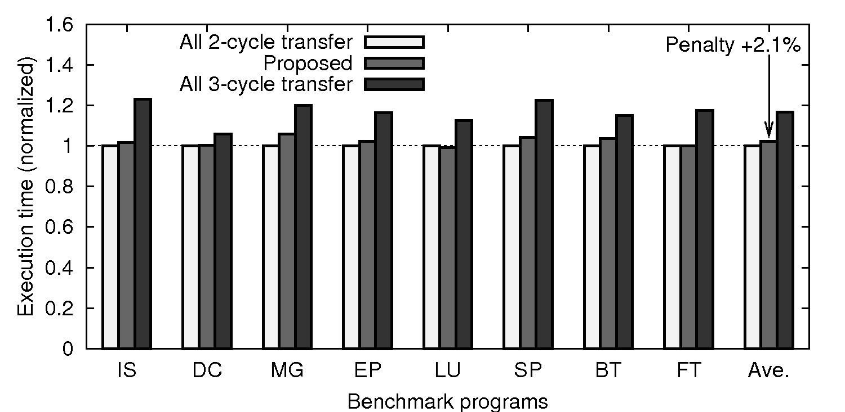
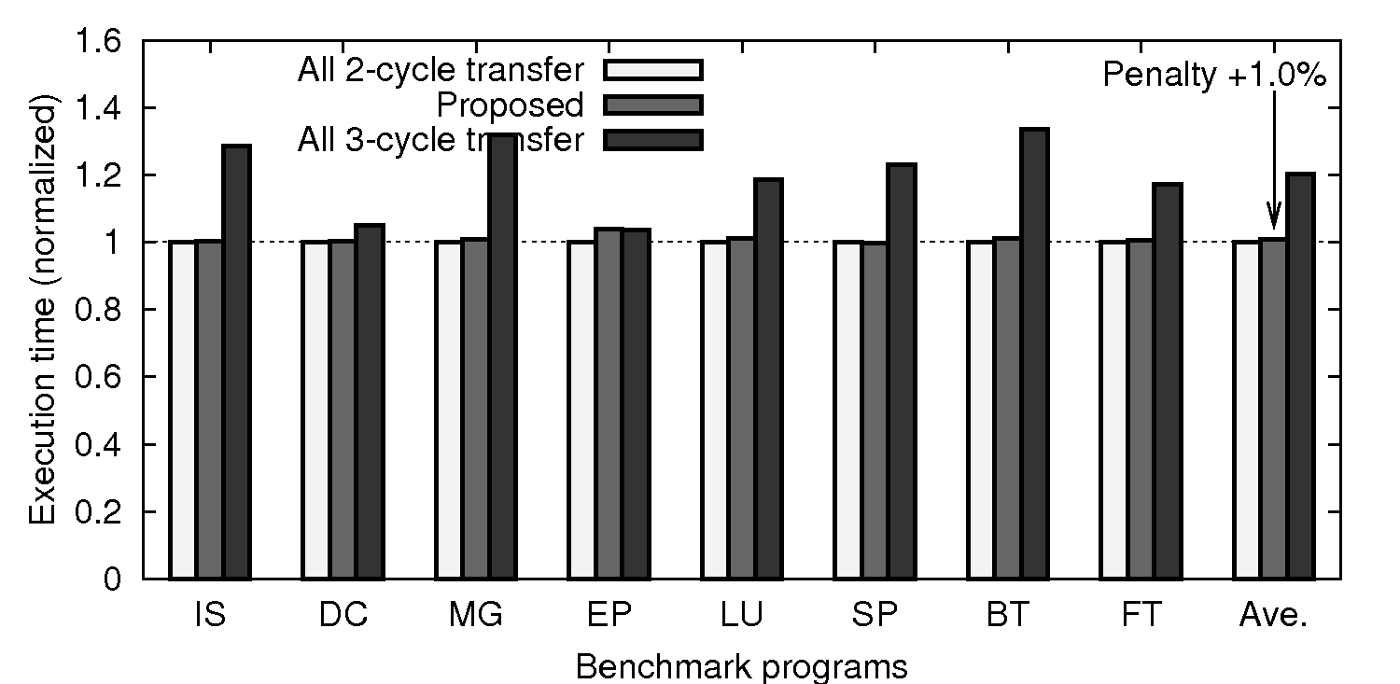
Low-power policy: Performance overhead
2-cycle @ Vdd-low when no packets come (standby mode)
1-cycle @ Vdd-high when packets come (except 1st hop)
All 1-cycle transfer
All 2-cycle transfer
Proposed
@ Vdd-high
@ Vdd-low
Shared L2 CMP
More communication
2.1% decrease compared to All 1-cycle@Vdd-high
Private L2 CMP
Less communication
1.0% decrease compared to All 1-cycle@Vdd-high

Slide 33
Low-power policy: Standby power reduction
2-cycle @ Vdd-low when no packets come (standby mode)
1-cycle @ Vdd-high when packets come (except 1st hop)
All 1-cycle transfer
All 2-cycle transfer
Proposed
@ Vdd-high
@ Vdd-low

Slide 34
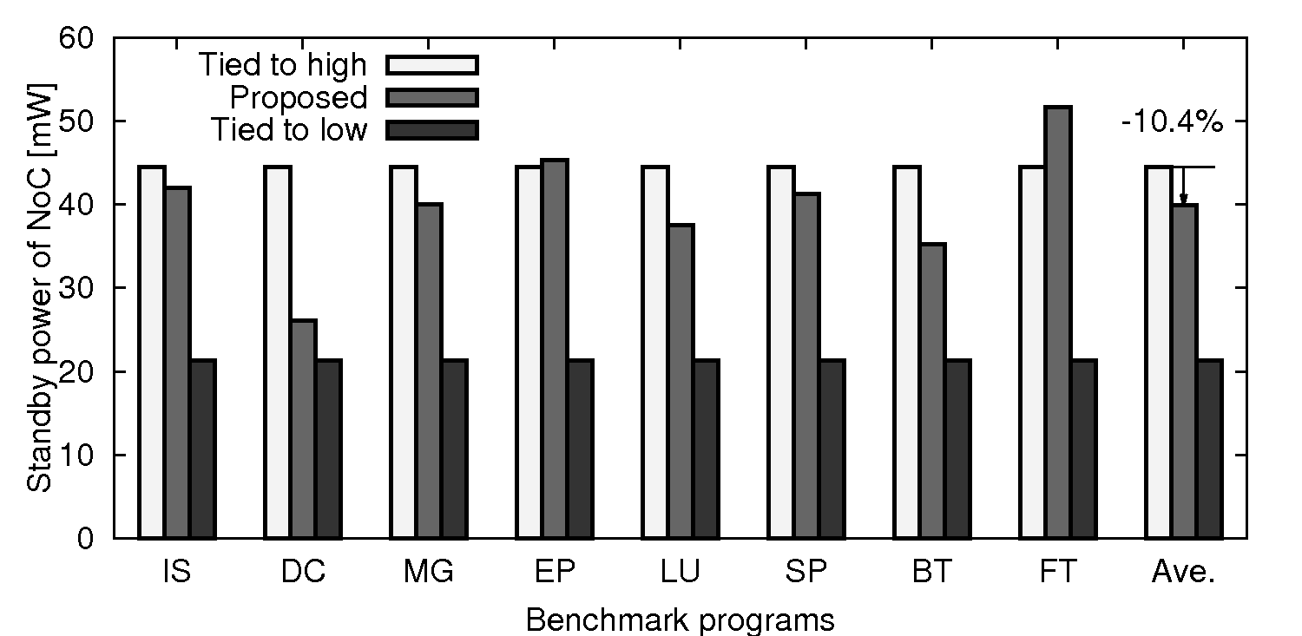
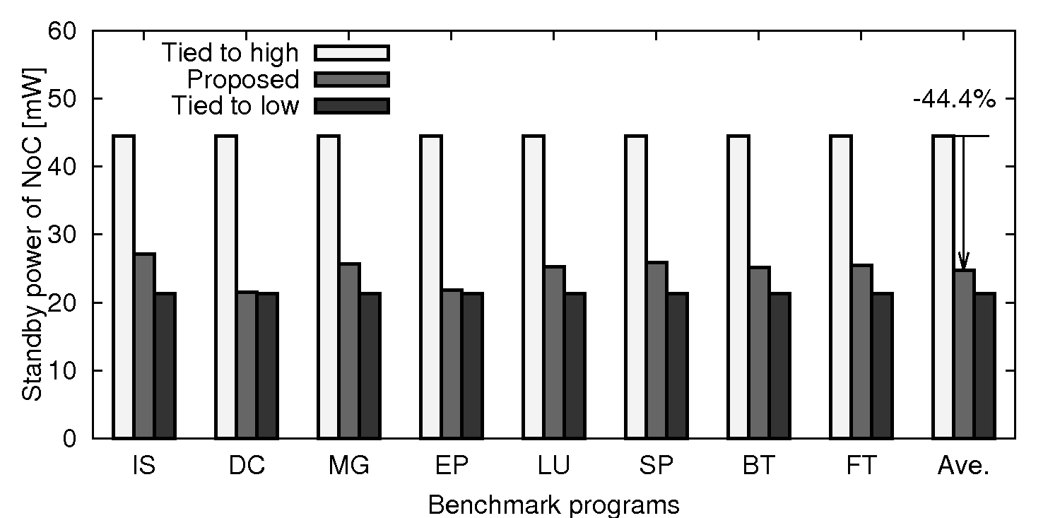
Low-power policy: Standby power reduction
2-cycle @ Vdd-low when no packets come (standby mode)
1-cycle @ Vdd-high when packets come (except 1st hop)
All 1-cycle transfer
All 2-cycle transfer
Proposed
@ Vdd-high
@ Vdd-low
Shared L2 CMP
More communication
10.4% reduction compared to All 1-cycle@Vdd-high
Private L2 CMP
Less communication
44.4% reduction compared to All 1-cycle@Vdd-high
Frequent short-term transitions less than BET

Slide 35
Summary: Multi-Vdd variable-pipeline router
Existing DVFS router
Voltage and frequency are adjusted
Multi-Vdd variable-pipeline router
Voltage and “router pipeline depth” are adjusted
All routers work at the same frequency
Voltage switch policies:
Low-power policy, and delay variation tolerance policy
Evaluation results:
Area overhead is 14.1%; Break-even time is 23 cycles
Performance degradation 1.0% to 2.1%
Standby power reduction 10.4% to 44.4%
Communication between different frequency domains introduces some difficulties…

Slide 36
On-going work
Thermal sensor design
Oscillation-Ring based Thermal Sensor (ORTS)
More sophisticated policies
Take into account Break-even time (BET) to avoid inefficient voltage transitions
E.g., Tied to 1-cycle@Vdd-high for high-volume traffic
Finer-grained multi-Vdd control
E.g., input channel or VC level to exploit traffic locality
Enable
[Yang,ASPDAC’09]
[Wolpert,NOCS’10]
Pulse counter
Thermal level

