Slide 1



A Case for Wireless 3D NoCs for CMPs
Hiroki Matsutani⁽¹⁾, Paul Bogdan⁽²⁾, Radu Marculescu⁽²⁾,
Yasuhiro Take⁽¹⁾, Daisuke Sasaki⁽¹⁾, Hao Zhang⁽¹⁾,
Michihiro Koibuchi⁽³⁾, Tadahiro Kuroda⁽¹⁾, Hideharu Amano⁽¹⁾
(1) Keio University, Japan
(2) Carnegie Mellon University, USA
(3) National Institute of Informatics, Japan

Slide 2
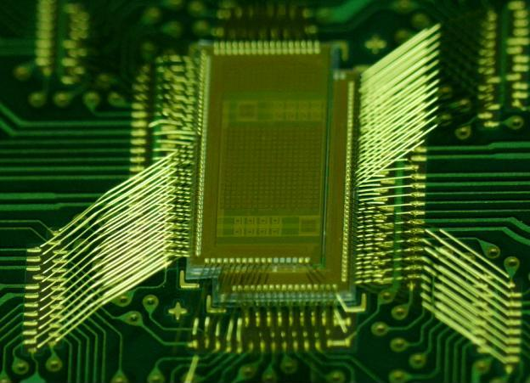
Outline: Wireless 3D NoC for CMPs
Background
  Many-core processors & Network-on-Chips (NoCs)
3D IC technologies
  Wired approach vs. wireless approach
Wireless 3D Chip multi-processors (CMPs)
Wireless 3D NoC architecture
  Irregular approach
  Spanning tree root optimization
Experimental results
  Real chip implementation
  Full-system simulation results

Slide 3
Multi-Core & Many-Core
picoChip PC102
picoChip PC205
256
ClearSpeed CSX700
128
ClearSpeed CSX600
Intel 80-core
64
TILERA TILE64
32
Intel SCC
Number of PEs (caches are not included)
MIT RAW
UT TRIPS (OPN)
16
STI Cell BE
8
Sun T1
Sun T2
Fujitsu SPARC64
4
Intel Core, IBM Power7
AMD Opteron
2
2002
2004
2006
2008
2010

Slide 4
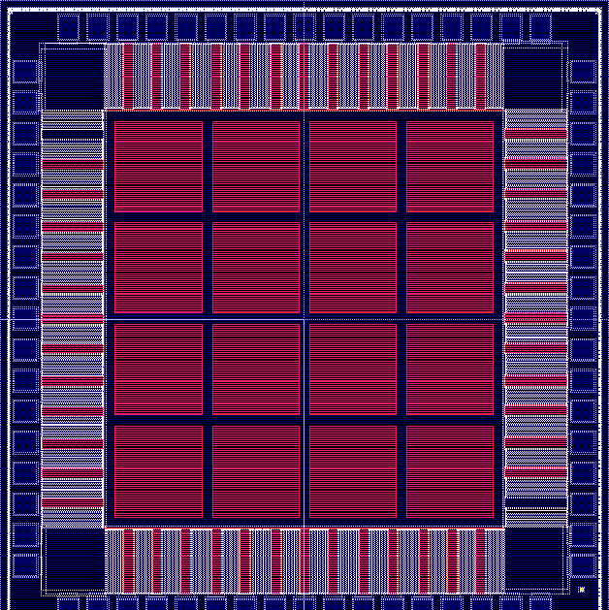
Network-on-Chip (NoC) is used for interconnecting many cores
Core
Router
16-Core Tile Architecture

Slide 5
Outline: Wireless 3D NoC for CMPs
Background
  Many-core processors & Network-on-Chips (NoCs)
3D IC technologies
  Wired approach vs. wireless approach
Wireless 3D Chip multi-processors (CMPs)
Wireless 3D NoC architecture
  Irregular approach
  Spanning tree root optimization
Experimental results
  Real chip implementation
  Full-system simulation results

Slide 6
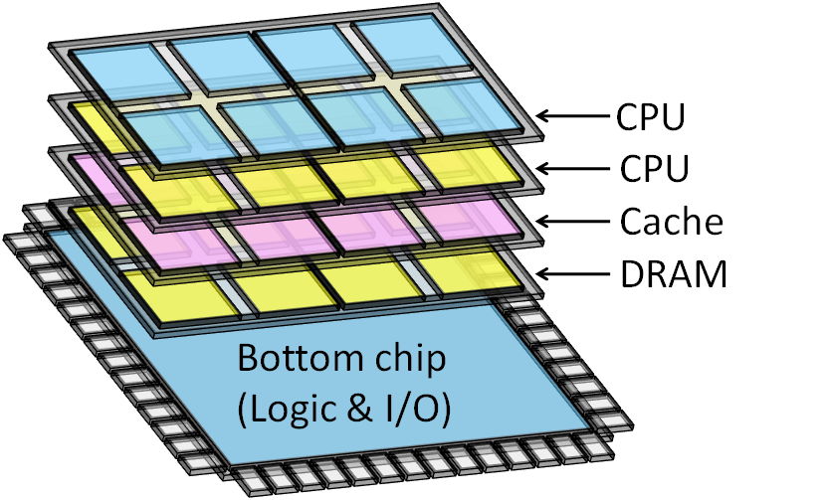
Design cost of LSI is increasing
System-on-Chip (SoC)
  Required components are integrated on a single chip
  Different LSI must be developed for each application
System-in-Package (SiP) or 3D IC
  Required components are stacked for each application
By changing the chips in a package, we can provide a wider range of chip family with modest design cost
Next slides show the techniques for stacking multiple chips
Notes:
Recently, the design cost of LSI is increasing rapidly. In conventional System-on-Chip, the required hardware components, such as microprocessors, reconfigurable devices, memories, are integrated on a single chip. So, different LSI must be developed for each application. However, developing a new mask pattern for each application is too expensive.
One of attractive solution to resolve this problem is System-in-Package, or 3D IC techniques. In 3D ICs, the required components or required chips are selected and stacked in a package for each application. By just changing the chips stacked in a package, we can provide a wider range of chip family with modest design cost.
So in this talk we are focusing on the 3D IC. The next slides show the 3D IC techniques for stacking multiple chips.

Slide 7
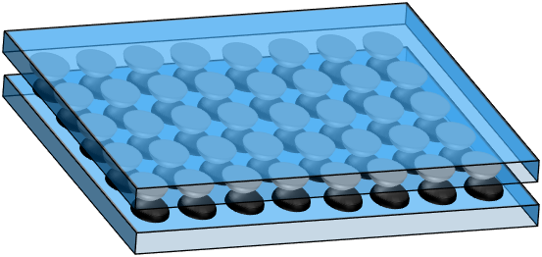
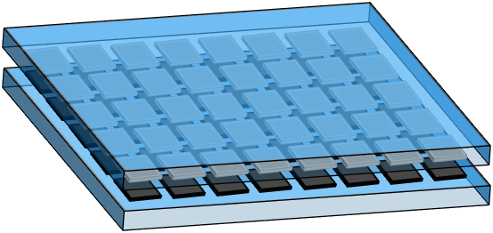
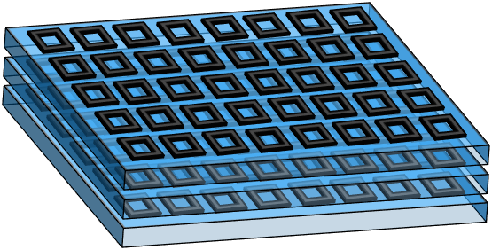
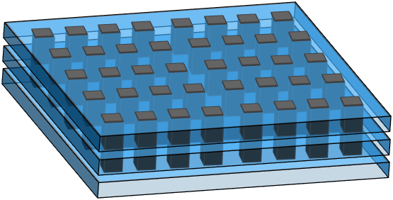
3D IC technology for going vertical
Wired
Wireless
Two chips (face-to-face)
Flexibility
Microbump
Capacitive coupling
Scalability
More than three chips
Through silicon via
Inductive coupling
Notes:
This figure shows the four representative 3D IC techniques: microbump, through silicon via, capacitive coupling, and inductive coupling. They are classified into wired and wireless approaches. Although the wired approaches, such as through silicon via, have been studied so far, the wired approaches cannot provide the flexibility that changes the chips in a package after the fabrication. So we focus on wireless approach.
In wireless approach, the capacitive coupling can stack only two chips by fact-to-fact connection. But the inductive coupling can stack more than three chips. So the inductive coupling provides the scalability to stack more than three chips and it also provides a flexibility to change the chips in a package after the fabrication.

Slide 8
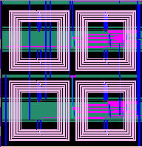
Inductive coupling link for 3D ICs
Stacking after chip fabrication
Only know-good-dies selected
More than 3 chips
Bonding wires
for power supply
We are developing prototype systems of wireless 3D ICs using the inductive coupling
Inductor for transceiver
Footprint of inductor
Implemented as a square coil with metal in common CMOS
Not a serious problem. Only
metal layers are occupied
Notes:
I talk more about the inductive coupling. This square shows the inductor for data transceiver. The inductor is implemented as square of coil with metal in common CMOS process. Size of inductor is relatively large compared to the through-silicon via. But the size of inductor is not a serious problem, because we compensate for inductor area by stacking plenty of chips.
Because of the flexibility and scalability of the inductive coupling, we developed a three-dimensional dynamically reconfigurable processor using the inductive coupling.

Slide 9
Outline: Wireless 3D NoC for CMPs
Background
  Many-core processors & Network-on-Chips (NoCs)
3D IC technologies
  Wired approach vs. wireless approach
Wireless 3D Chip multi-processors (CMPs)
Wireless 3D NoC architecture
  Irregular approach
  Spanning tree root optimization
Experimental results
  Real chip implementation
  Full-system simulation results

Slide 10
Our target: Original 2D CMPs
Chip multi processor (CMP)
  Multiple processors (each has private L1 cache)
  Shared L2 cache divided into multiple banks (SNUCA)
Processor tile
Cache tile
UltraSPARC
L1 cache (I & D)
L2 cache bank

Slide 11
Our target: Original 2D CMPs
Chip multi processor (CMP)
  Multiple processors (each has private L1 cache)
  Shared L2 cache divided into multiple banks (SNUCA)
  Processors and L2 banks are connected via NoC
UltraSPARC
L1 cache (I & D)
L2 cache bank
On-chip router

Slide 12
Wireless 3D CMP: Homogeneous
2D is divided into 8 planes
  Stacking the same chips
Chip 7
Chip 2
Chip 1
Chip 0

Slide 13
Wireless 3D CMP: Heterogeneous
Types and number of chips are customized for applications
For memory-bound applications,
  More cache chips are added
For computation-bound applications,
  More processor chips are added
Chip 7
Chip 2
Chip 1
Chip 0
Chips should be added, removed, swapped for each application

Slide 14
Outline: Wireless 3D NoC for CMPs
Background
  Many-core processors & Network-on-Chips (NoCs)
3D IC technologies
  Wired approach vs. wireless approach
Wireless 3D Chip multi-processors (CMPs)
Wireless 3D NoC architecture
  Irregular approach
  Spanning tree root optimization
Experimental results
  Real chip implementation
  Full-system simulation results

Slide 15
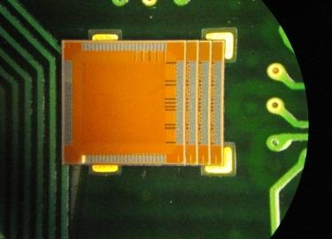
Big picture: Wireless 3D NoC
Arbitrary chips are stacked after fabrication
  Each chip has vertical links at pre-specified locations, but we do not know internal topology of each chip.
  Wireless 3D NoC required to stack unknown topologies
Memory chip from A
Required chips are stacked for each application
GPU chip
from B
CPU chip from C
An example (4 chips)

Slide 16
Two approaches: Wireless 3D NoC arch
Chips should be added, removed, swapped for each application
Ring-based approach
  Easy to add, remove, …
  Inefficient hop count
  No scalability
Irregular approach
  We can use any links
  Irregular routing needed
  Plug-and-play protocol
Good
Good
Bad
Bad
[Matsutani,NOCS’11]
Chip 4
Chip 4
Chip 3
Chip 3
Chip 2
Chip 2
Chip 1
Chip 1
Chip 0
Chip 0

Slide 17
Irregular approach: Ad-hoc topology
Wireless 3D CMP
  Various chips are stacked, depending on the application
Each chip
  Must have vertical links
  May not have horizontal links
  May have VCs for horizontal
Ad-hoc wireless 3D NoC
  We cannot expect the network topology, number of VCs, and its bandwidth before stacking
Chip 7
Chip 2
Chip 1
Chip 0

Slide 18
Irregular approach: Ad-hoc topology
Wireless 3D CMP
  Various chips are stacked, depending on the application
Each chip
  Must have vertical links
  May not have horizontal links
  May have VCs for horizontal
Ad-hoc wireless 3D NoC
  We cannot expect the network topology, number of VCs, and its bandwidth before stacking
Chip 7
Chip 2
Chip 1
Chip 0

Slide 19
Irregular approach: Ad-hoc topology
Wireless 3D CMP
  Various chips are stacked, depending on the application
Each chip
  Must have vertical links
  May not have horizontal links
  May have VCs for horizontal
Ad-hoc wireless 3D NoC
  We cannot expect the network topology, number of VCs, and its bandwidth before stacking
Chip 7
No horizontal link
Chip 2
Chip 1
Chip 0

Slide 20
Irregular approach: Ad-hoc topology
Wireless 3D CMP
  Various chips are stacked, depending on the application
Each chip
  Must have vertical links
  May not have horizontal links
  May have VCs for horizontal
Ad-hoc wireless 3D NoC
  We cannot expect the network topology, number of VCs, and its bandwidth before stacking
Chip 7
Chip 2
Chip 1
Chip 0
Extreme case: only the bottom has link
We need a mechanism to route packets even with such cases

Slide 21
Irregular approach: Up*/down* routing
Up*/down* (UD) routing
  Irregular network routing
  A root node is selected
  Packets go up and then go down
An example
  4x4 2D mesh
  A root node is selected
[Schroeder,JSAC’91]
Root
0
0
1
2
3
4
5
6
7
8
9
10
11
12
13
14
15

Slide 22
Irregular approach: Up*/down* routing
Up*/down* (UD) routing
  Irregular network routing
  A root node is selected
  Packets go up and then go down
An example
  4x4 2D mesh
  Direction (up or down) is determined
[Schroeder,JSAC’91]
Up direction
Root
0
1
2
3
4
5
6
7
8
9
10
11
12
13
14
15

Slide 23
Irregular approach: Up*/down* routing
Up*/down* (UD) routing
  Irregular network routing
  A root node is selected
  Packets go up and then go down
An example
  4x4 2D mesh
  Routing path is generated
  Down-up turn is prohibited
  It generates imbalanced paths…
[Schroeder,JSAC’91]
Up direction
Root
0
1
2
3
OK
4
5
6
7
8
9
10
11
NG
12
13
14
15

Slide 24
Irregular approach: Up*/down* routing
Up*/down* (UD) routing
  Irregular network routing
  A root node is selected
  Packets go up and then go down
Another example
  3D NoC with 4 chips
[Schroeder,JSAC’91]
Root
Chip 3
0
1
Chip 2
2
3
Chip 1
4
5
Chip 0
6
7

Slide 25
Irregular approach: Up*/down* routing
Up*/down* (UD) routing
  Irregular network routing
  A root node is selected
  Packets go up and then go down
Another example
  3D NoC with 4 chips
[Schroeder,JSAC’91]
Root
Chip 3
0
1
Chip 2
2
3
Chip 1
4
5
Chip 0
6
7

Slide 26
Irregular approach: Up*/down* routing
Up*/down* (UD) routing
  Irregular network routing
  A root node is selected
  Packets go up and then go down
Another example
  3D NoC with 4 chips
[Schroeder,JSAC’91]
Root
Chip 3
0
1
OK
Chip 2
2
3
Chip 1
4
NG
5
Chip 0
The best spanning tree root is selected by exhaustive or heuristic using communication traces (9sec for 64-tile)
6
7

Slide 27
Irregular approach: UD with VCs
[Koibuchi,ICPP’03]
UD routing with multiple VCs
  Each layer (VC) has its own spanning tree
  Packets can transit multiple layers in descent order
[Lysne,TPDS’06]
Root
Chip 3
Chip 3
0
1
0
1
You can use either VC0 or VC1
OK
Chip 2
Chip 2
2
3
2
3
Chip 1
Chip 1
4
OK
5
4
5
Chip 0
VC1
Chip 0
VC0
How to recognize the topology & build multiple spanning trees?
6
Root’
7
6
7

Slide 28
Irregular approach: Plug & play protocol
Topology info is stored in each chip (e.g. in E2PROM)
An elected processor P broadcasts a probe packet
Each chip replies the topology info to node P
Node P computes routing tables of all routers
Routing tables are updated
Elected CPU
Chip 4
Chip 3
Chip 2
Chip 1
Chip 0
Topology info

Slide 29
Irregular approach: Plug & play protocol
Topology info is stored in each chip (e.g. in E2PROM)
An elected processor P broadcasts a probe packet
Each chip replies the topology info to node P
Node P computes routing tables of all routers
Routing tables are updated
Elected CPU
Chip 4
Chip 3
Chip 2
Chip 1
Chip 0
Topology info

Slide 30
Irregular approach: Plug & play protocol
Topology info is stored in each chip (e.g. in E2PROM)
An elected processor P broadcasts a probe packet
Each chip replies the topology info to node P
Node P computes routing tables of all routers
Routing tables are updated
Elected CPU
Chip 4
Chip 3
Chip 2
Chip 1
Chip 0
Topology info

Slide 31
Outline: Wireless 3D NoC for CMPs
Background
  Many-core processors & Network-on-Chips (NoCs)
3D IC technologies
  Wired approach vs. wireless approach
Wireless 3D Chip multi-processors (CMPs)
Wireless 3D NoC architecture
  Irregular approach
  Spanning tree root optimization
Experimental results
  Real chip implementation
  Full-system simulation results

Slide 32
Full-system CMP simulations
Application performance of two approaches is evaluated
Ring-based approach
  Easy to add, remove, …
  Inefficient hop count
  No scalability
Irregular approach
  50% of horizontal links
  Irregular routing
  Optimized spanning tree
Good
Bad
Bad
[Matsutani,NOCS’11]
Chip 4
Chip 4
Chip 3
Chip 3
Chip 2
Chip 2
Chip 1
Chip 1
Chip 0
Chip 0

Slide 33
Network topology: Irregular
The following iteration is performed 1,000 times
  Each tile has router and core (e.g., processor or caches)
  Each horizontal link appears with 50%
We examined three cases: 16, 32, and 64 tiles
16-tile (2,2,4)
32-tile (4,2,4)
64-tile (4,4,4)
2x2 mesh * 4chips
4x2 mesh * 4chips
4x4 mesh * 4chips

Slide 34
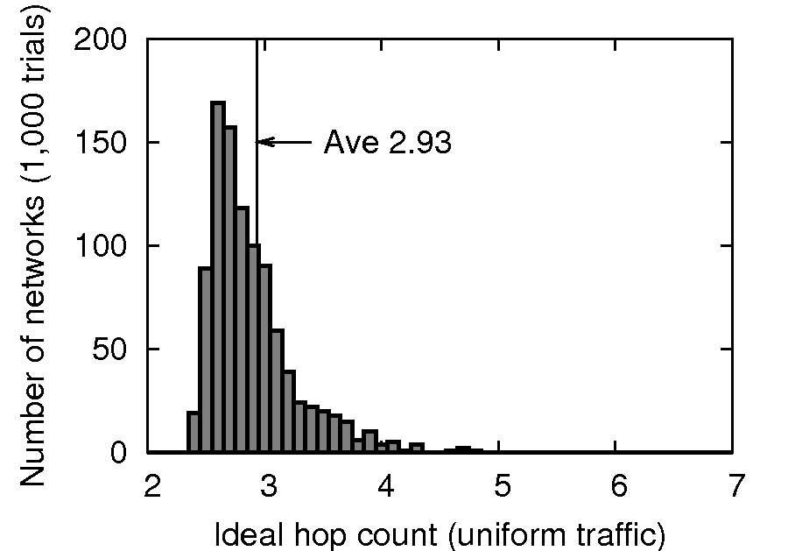
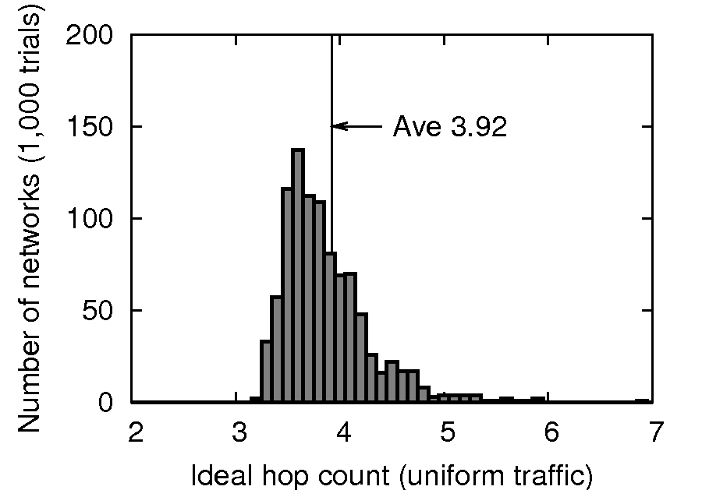
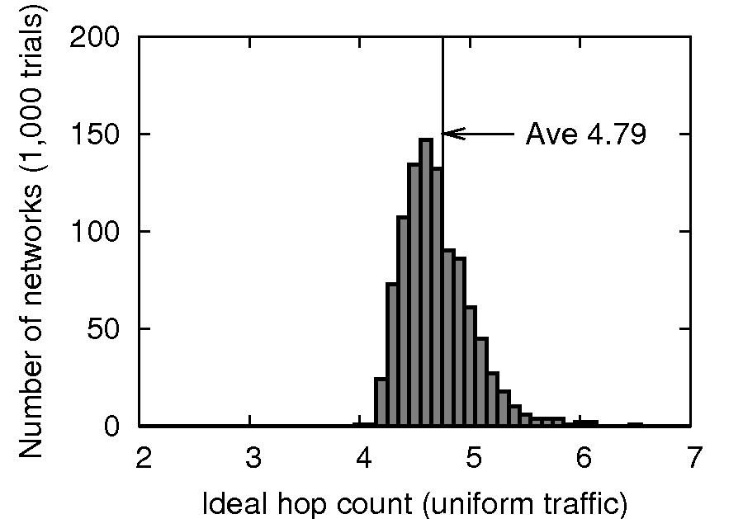
Network topology: Irregular
The following iteration is performed 1,000 times
  Each tile has router and core (e.g., processor or caches)
  Each horizontal link appears with 50%
We examined three cases: 16, 32, and 64 tiles
Among 1,000 random topologies, one with the most typical hop count value is selected for the full-system evaluation
16-tile (2,2,4)
32-tile (4,2,4)
64-tile (4,4,4)
2x2 mesh * 4chips
4x2 mesh * 4chips
4x4 mesh * 4chips

Slide 35
Parallel programs are running on it
GEMS/Simics is used for full-system simulations
Ring-based approach
  Easy to add, remove, …
  Inefficient hop count
  No scalability
Irregular approach
  50% of horizontal links
  Irregular routing
  Optimized spanning tree
Good
Bad
Bad
[Matsutani,NOCS’11]
Chip 4
Chip 4
Chip 3
Chip 3
Chip 2
Chip 2
Chip 1
Chip 1
Chip 0
Chip 0

Slide 36
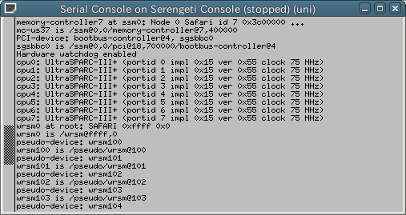
Parallel programs are running on it
GEMS/Simics is used for full-system simulations
Table 1: Topologies to be examined
 | Routers | CPUs | L2$banks | MCs
16-tile | 16 | 4 | 32 | 4
32-tile | 32 | 8 | 64 | 8
64-tile | 64 | 8 | 128 | 16
Table 2: Simulation parameters
L1$ size & latency | 64K / 1cycle
L2$ size & latency | 256K / 6cycle
Memory size & latency | 4G / 160cycle
Router latency | [RC/VSA] [ST] [LT]
Router buffer size | 5-flit per VC
Protocol | MOESI directory
Solaris 9 is running on
8-core UltraSPARC
Table 3: Application programs
NPB (IS, DC, CG, MG, EP, LU, UA, SP, BT, FT)

Slide 37
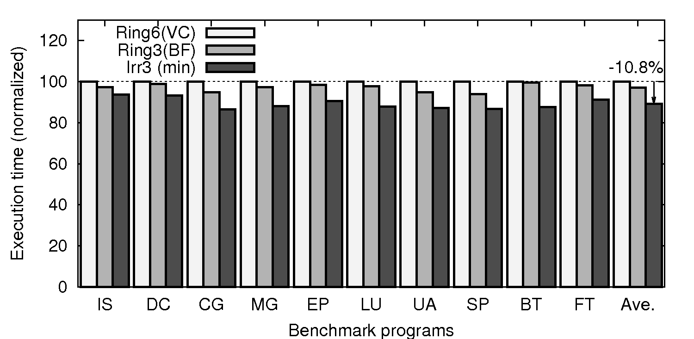
Application exec time: 16-tile
Ring-based approach (VC flow & Bubble flow controls)
Irregular approach
Irregular approach outperforms Ring-based one by 10.8% in 16-tile case.

Slide 38
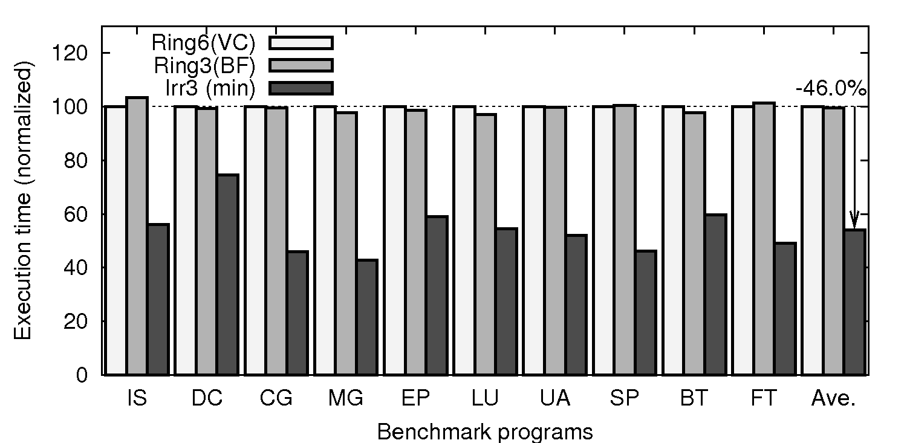
Application exec time: 64-tile
Ring-based approach (VC flow & Bubble flow controls)
Irregular approach
Irregular approach outperforms Ring-based one by 46.0% in 64-tile case.
Ring has no scalability → Irregular one improves significantly

Slide 39
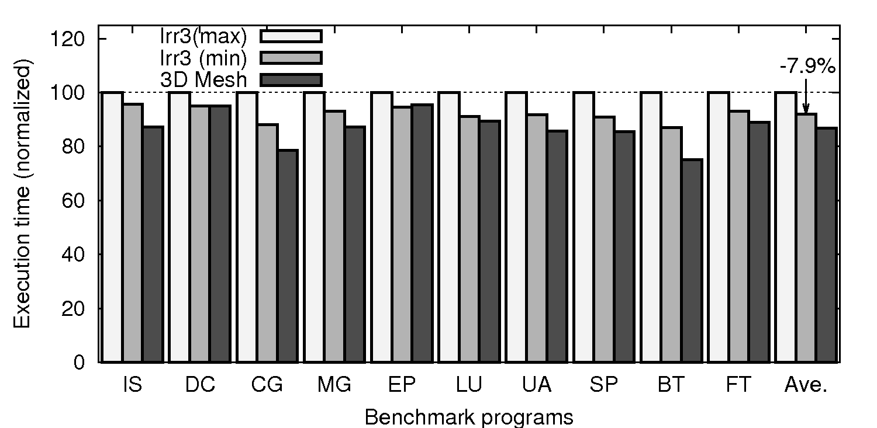
Application exec time: 16-tile
Irregular (50% of horizontal links are implemented)
3D mesh (all horizontal links are implemented)
Performance of Irregular approach Irr3(min) is closed to that of 3D mesh

Slide 40
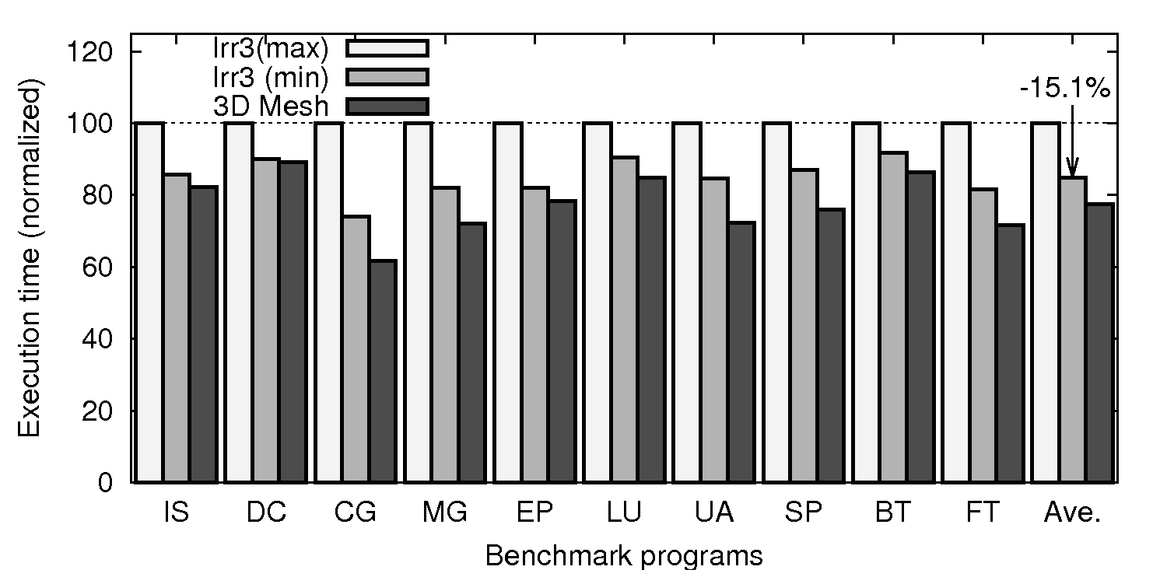
Application exec time: 64-tile
Irregular (50% of horizontal links are implemented)
3D mesh (all horizontal links are implemented)
Performance of Irregular approach Irr3(min) is closed to that of 3D mesh
Optimized Irr3(min) improves by 15.1% compared to the worst

Slide 41
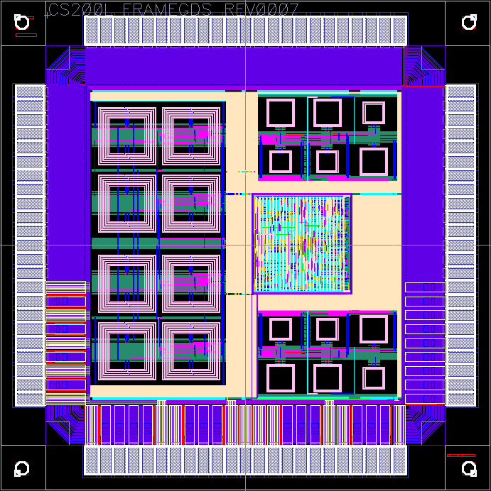
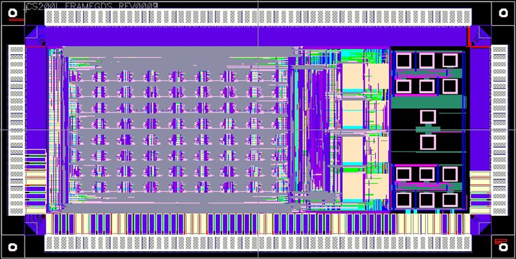
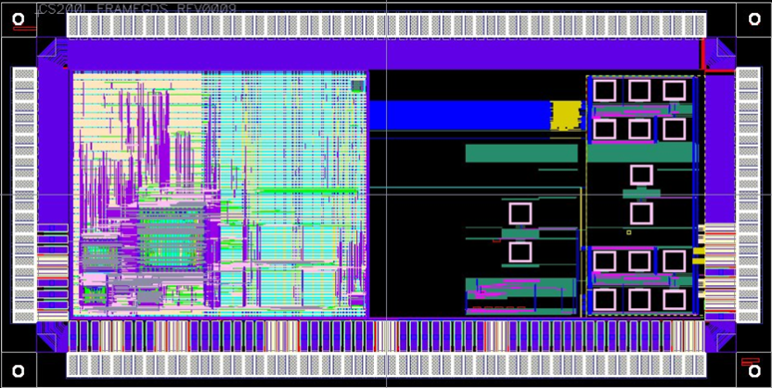
Our wireless 3D chips
Cube-0
  Only for testing
  Wireless routers
Cube-1 (CPU ver.)
  MIPS-like CPU
  Wireless routers
Cube-1 (PE array ver.)
  Processing array
  Wireless routers
Vertical links
Routers
(NoC)

Slide 42
Summary: Wireless 3D NoC for CMPs
Background
  Wired vs. wireless 3D ICs
  Wireless 3D Chip multi-processors (CMPs)
Wireless 3D NoC architecture
  Ring-based approach
  Irregular approach with spanning tree root optimization
Full-system simulation results
  Irregular approach with root optimization improves the performance by 15.1% compared to the worst case
  Irregular approach has more scalability than Ring one
  Irregular approach with 50% horizontal links shows small performance degradation compared to 3D mesh
[Matsutani,NOCS’11]

