Slide 1




Low-Latency Wireless 3D NoCs via Randomized Shortcut Chips
Hiroki Matsutani 1 | Michihiro Koibuchi 2 | Ikki Fujiwara 2
Takahiro Kagami 1 | Yasuhiro Take 1 | Tadahiro Kuroda 1
Paul Bogdan 3 | Radu Marculescu 4 | Hideharu Amano 1
1 Keio Univ (Japan) | 2 NII (Japan)
3 USC (USA) | 4 CMU (USA)

Slide 2
Outline: Random chip for 3D WiNoCs
3D Wireless NoCs (3D WiNoCs) [7min]
  Wireless 3D IC technology
  3D WiNoC design example (65nm)
Adding random NoC chip for 3D WiNoCs [8min]
  Adding randomness induces small-world effects
  Adding random NoC chip to NoC-less 3D ICs
  Replacing regular 2D NoC with random 2D NoC
Design space exploration [5min]
Experiment results and Summary [5min]

Slide 3
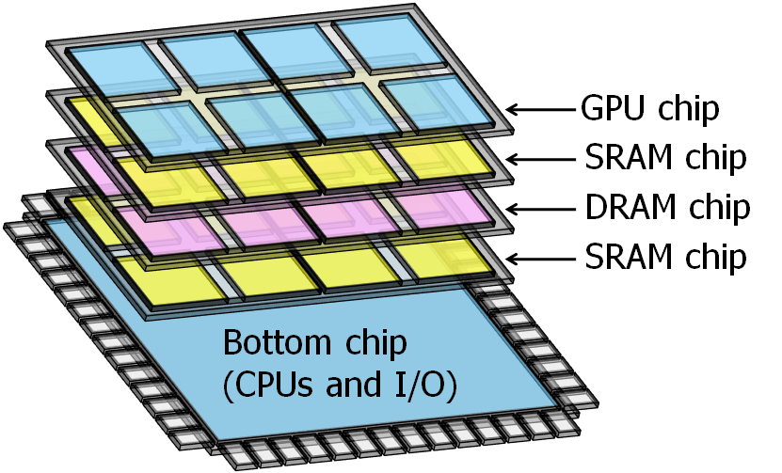
Design cost of LSI is increasing
System-on-Chip (SoC)
  Required components are integrated on a single chip
  Different LSI must be developed for each application
System-in-Package (SiP) or 3D IC
  Required components are stacked for each application
By changing the chips in a package, we can provide a wider range of chip family with modest design cost

Slide 4
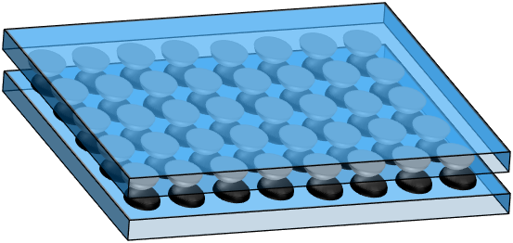
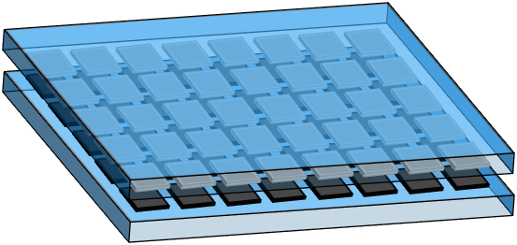
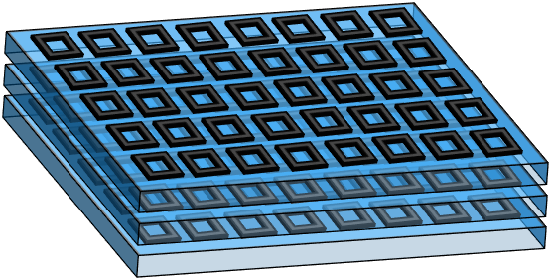
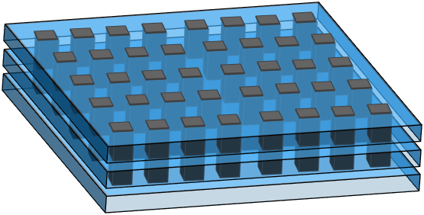
3D IC technology for going vertical
Wired
Wireless
Two chips (face-to-face)
Flexibility
Microbump
Capacitive coupling
Scalability
More than three chips
Through silicon via
Inductive coupling

Slide 5
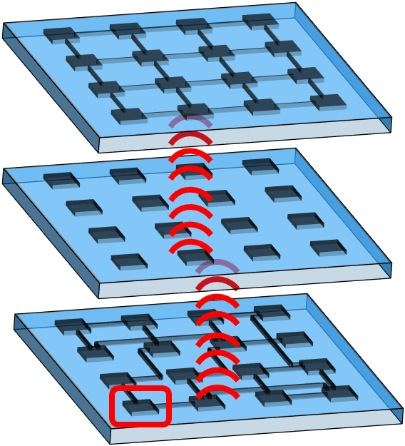
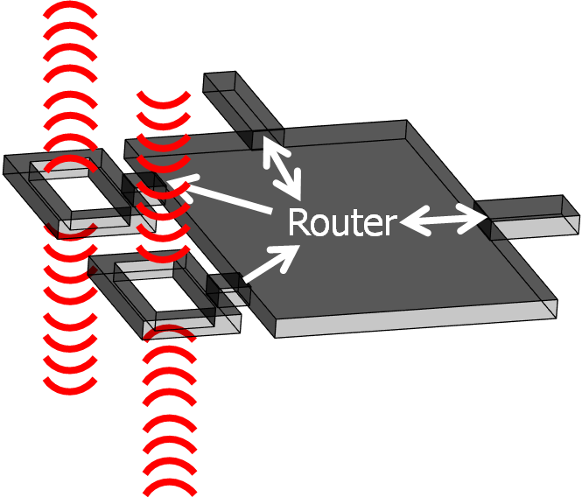
3D Wireless NoC (3D WiNoC)
Three chips are stacked wirelessly
Each router has a wireless transceiver
Each router has TX/RX coils (inductors)
Coils are implemented with metal layers
Chip#2
TX
Chip#1
Chip#0
RX

Slide 6
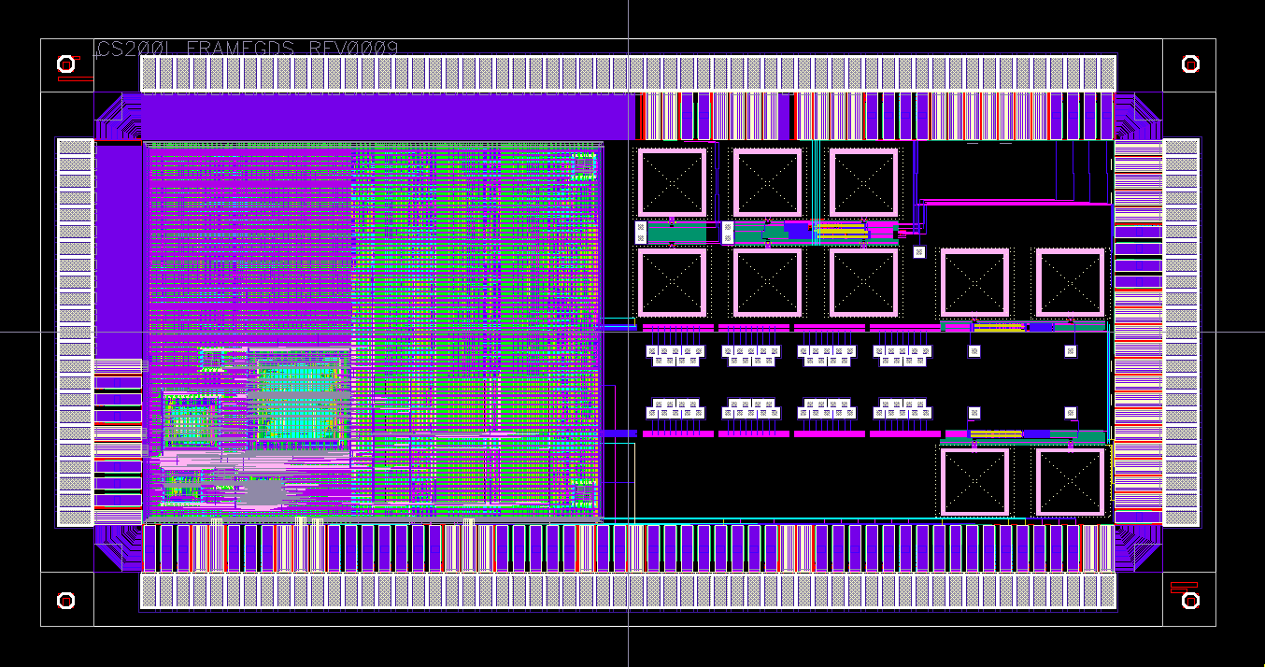
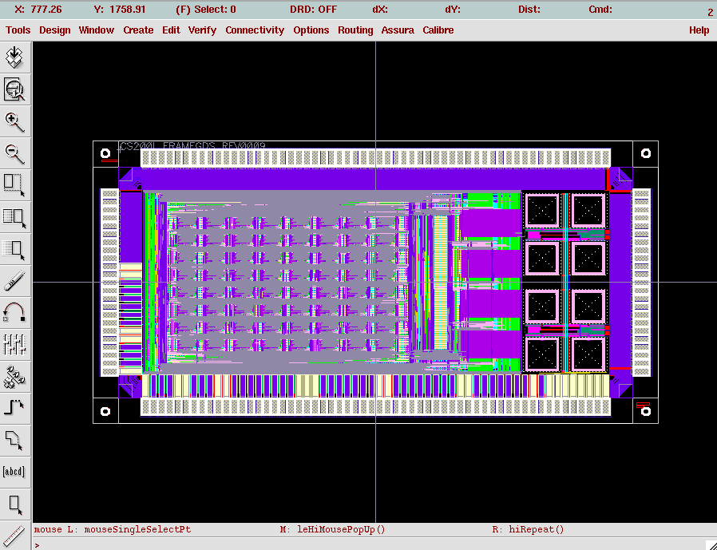
An example: Cube-1 (2012)
Test chips for building-block 3D systems
  Two chip types: Host CPU chip & Accelerator chip
  We can customize number & types of chips in SiP
Cube-1 Host CPU chip
  Two 3D wireless routers
  MIPS-like CPU
Cube-1 Accelerator chip
  Two 3D wireless routers
  Processing element array
[Miura, IEEE Micro 13]
MIP CPU
Core
Inductors
8x8
PE Array

Slide 7
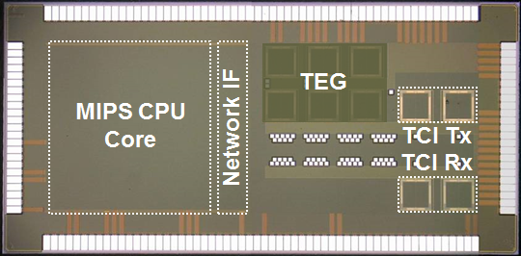
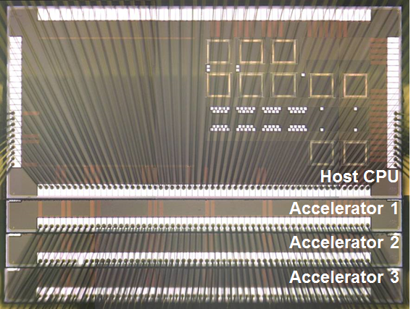
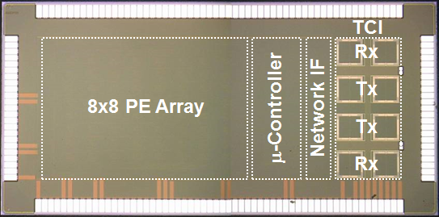
An example: Cube-1 (2012)
We can change the number and types of chips in a package according to application requirements
Microphotographs of test chips
[Miura, IEEE Micro 13]
Host CPU Chip
Host CPU + 3 Accelerators
Accelerator Chip

Slide 8
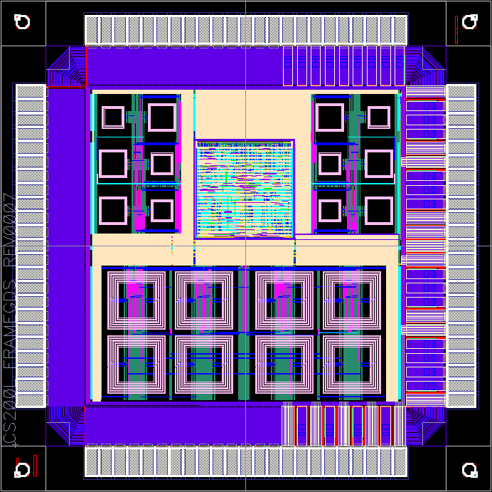
An example: Cube-0 (2010)
Either vertical P2P links or broadcast bus can be formed for 3D WiNoC
Test chip for vertical communication schemes
  Vertical point-to-point link between adjacent chips
  Vertical shared bus (broadcast)
2.1mm x 2.1mm
[Matsutani, NOCS’11]
TX
RX
Inductors (P2P)
Stacking for
Ring network
Core 0 & 1
TX/RX
Router 0 & 1
Stacking for
Vertical bus
Inductors (bus)

Slide 9
Outline: Random chip for 3D WiNoCs
3D Wireless NoCs (3D WiNoCs) [7min]
  Wireless 3D IC technology
  3D WiNoC design example (65nm)
Adding random NoC chip for 3D WiNoCs [8min]
  Adding randomness induces small-world effects
  Adding random NoC chip to NoC-less 3D ICs
  Replacing regular 2D NoC with random 2D NoC
Design space exploration [5min]
Experiment results and Summary [5min]

Slide 10
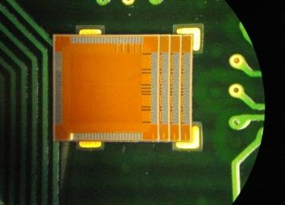
Big picture: 3D Wireless NoC
Arbitrary chips are stacked after fabrication
  Each chip has vertical links at pre-specified locations, but we do not know internal topology of each chip
  Some chips may not have horizontal NoC (vertical link only)
CPU chip from A
Required chips are stacked for each application
Application chip from B
Memory chip from C
An example (4 chips)
Inductor (vertical link)

Slide 11
Big picture: 3D Wireless NoC
Arbitrary chips are stacked after fabrication
  Each chip has vertical links at pre-specified locations, but we do not know internal topology of each chip
  Some chips may not have horizontal NoC (vertical link only)
Adding randomness induces small-world effect
Here we examine two cases:
Adding random NoC chip to NoC-less 3D ICs
Replacing regular 2D NoC with random 2D NoC
CPU chip from A
Required chips are stacked for each application
Application chip from B
Memory chip from C
An example (4 chips)
Inductor (vertical link)

Slide 12
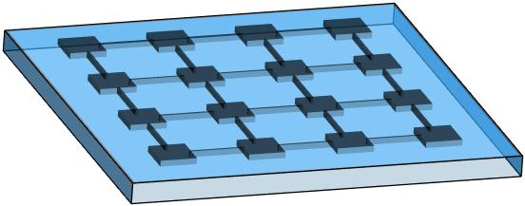
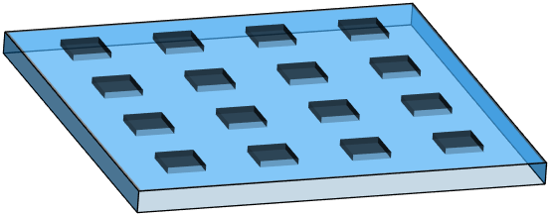
Big picture: 3D WiNoC w/ Random
Router IP macros have the same # of ports
  Unused ports can be used for long-range links
  In addition, redundant links are implemented and statically multiplexed by FPGA-like switch boxes
  By reconfiguring the switch boxes, an unique random wire pattern can be generated

Slide 13
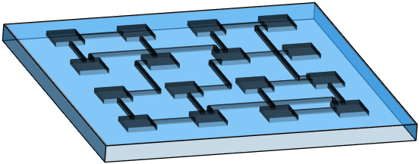
Big picture: 3D WiNoC w/ Random
Router IP macros have the same # of ports
  Unused ports can be used for long-range links
  In addition, redundant links are implemented and statically multiplexed by FPGA-like switch boxes
  By reconfiguring the switch boxes, an unique random wire pattern can be generated

Slide 14
Case 1: Random NoC to NoC-less 3D ICs
Each chip has inductors but does not have 2D NoC
  Inductors in the same pillar form a vertical broadcast bus
  Horizontal connectivity is not provided at all (i.e., NoC-less)
Chip#2
NoC-less
Chip#2
Vertical
broadcast bus
Chip#1
NoC-less
Chip#1
Chip#0
NoC-less
Chip#0
“― ― ―” Configuration
Side view (3 chips)

Slide 15
Case 1: Random NoC to NoC-less 3D ICs
Each chip has inductors but does not have 2D NoC
  Inductors in the same pillar form a vertical broadcast bus
  Adding a 2D Mesh NoC to such NoC-less 3D IC
Chip#2
2D Mesh
Chip#2
Destination
Chip#1
NoC-less
Chip#1
Source
Chip#0
NoC-less
Chip#0
“m ― ―” Configuration
Side view (3 chips)

Slide 16
Case 1: Random NoC to NoC-less 3D ICs
Each chip has inductors but does not have 2D NoC
  Inductors in the same pillar form a vertical broadcast bus
  Adding a Random NoC to such NoC-less 3D IC
Chip#2
Random
Chip#2
Destination
Chip#1
NoC-less
Chip#1
Source
Chip#0
NoC-less
Chip#0
“r ― ―” Configuration
Side view (3 chips)

Slide 17
Case 1: Random NoC to NoC-less 3D ICs
Each chip has inductors and partially has 2D NoC
  Inductors in the same pillar form a vertical broadcast bus
  We call this configuration partial-NoC 3D IC
Chip#2
NoC-less
Chip#2
Destination
Chip#1
NoC-less
Source
Chip#1
Chip#0
2D Mesh
Chip#0
“― ― m” Configuration
Side view (3 chips)

Slide 18
Case 1: Random NoC to NoC-less 3D ICs
Each chip has inductors and partially has 2D NoC
  Inductors in the same pillar form a vertical broadcast bus
  Adding a Random NoC to a partial-NoC 3D IC
Chip#2
Random
Chip#2
Destination
Chip#1
NoC-less
Source
Chip#1
Chip#0
2D Mesh
Chip#0
“r ― m” Configuration
Side view (3 chips)

Slide 19
Case 2: Replacing regular NoC w/ random
3D WiNoC that consists of three 2D Mesh NoC layers
  Inductors in neighboring chips form a vertical P2P link
  E.g., regular 3D Mesh topology (i.e., regular 3D NoC)
Chip#2
2D Mesh
Chip#2
Vertical
point-to-point link
Chip#1
2D Mesh
Chip#1
Chip#0
2D Mesh
Chip#0
“m m m” Configuration
Side view (3 chips)

Slide 20
Case 2: Replacing regular NoC w/ random
3D WiNoC that consists of three 2D Mesh NoC layers
  Inductors in neighboring chips form a vertical P2P link
  Replacing regular 2D Mesh with random NoC
Chip#2
2D Mesh
Chip#2
2D Mesh
Chip#1
2D Mesh
Chip#1
Random
Chip#0
2D Mesh
Chip#0
2D Mesh
“m m m” Configuration
“m r m” Configuration

Slide 21
Routing: Spanning tree optimization
Packets are routed based on up*/down* rule
  Up & Down directions are assigned based on root node
  Packets go up and then go down
Spanning tree root is selected based on an optimization method [Matsutani,ASPDAC’13]
Root
Chip 3
Chip 3
0
1
0
1
You can use either VC0 or VC1
OK
Chip 2
Chip 2
2
3
2
3
Chip 1
Chip 1
4
OK
5
4
5
Chip 0
VC1
Chip 0
VC0
6
Root’
7
6
7

Slide 22
Outline: Random chip for 3D WiNoCs
3D Wireless NoCs (3D WiNoCs) [7min]
  Wireless 3D IC technology
  3D WiNoC design example (65nm)
Adding random NoC chip for 3D WiNoCs [8min]
  Adding randomness induces small-world effects
  Adding random NoC chip to NoC-less 3D ICs
  Replacing regular 2D NoC with random 2D NoC
Design space exploration [5min]
Experiment results and Summary [5min]

Slide 23
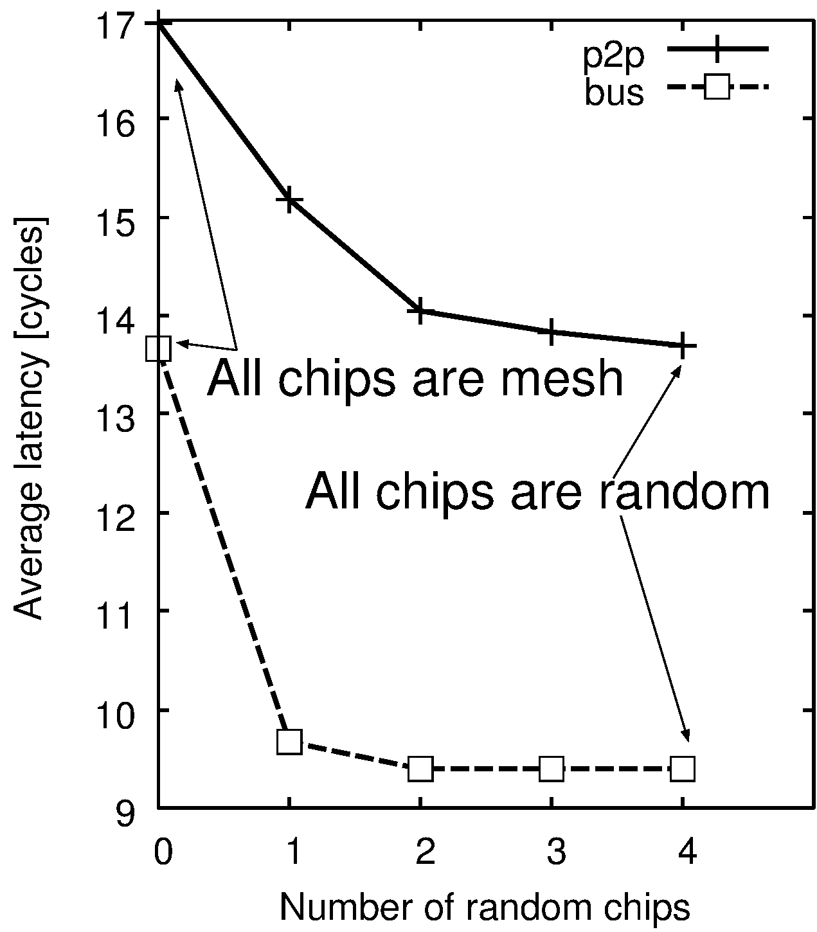
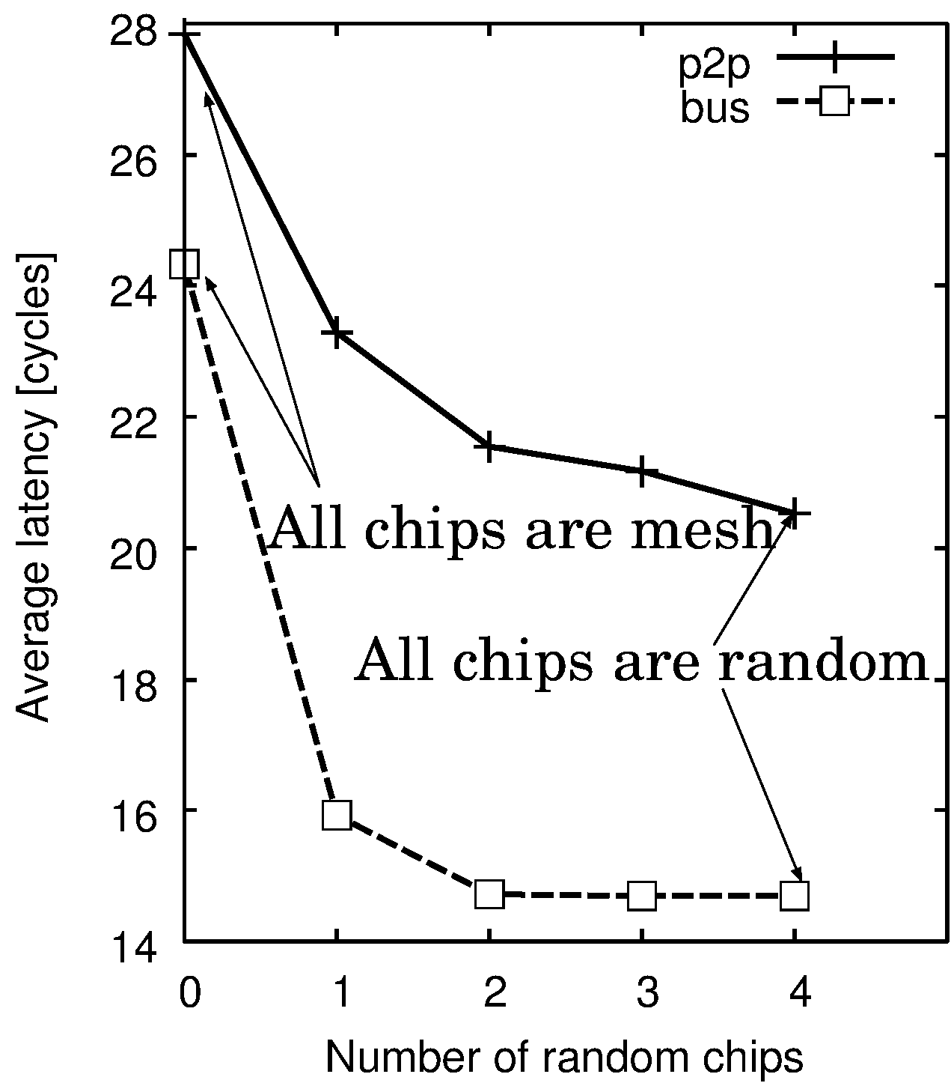
Q1: How many random chips do we need?
Number of random chips vs. Average latency
P2P
Bus
P2P
Bus
1 random chip drastically reduces latency
# of random chips (16-node)
# of random chips (64-node)

Slide 24
Q1: How many random chips do we need?
Number of random chips vs. Average latency
P2P
Bus
P2P
Bus
1 or 2 random chips are enough in the P2P case
# of random chips (16-node)
# of random chips (64-node)

Slide 25
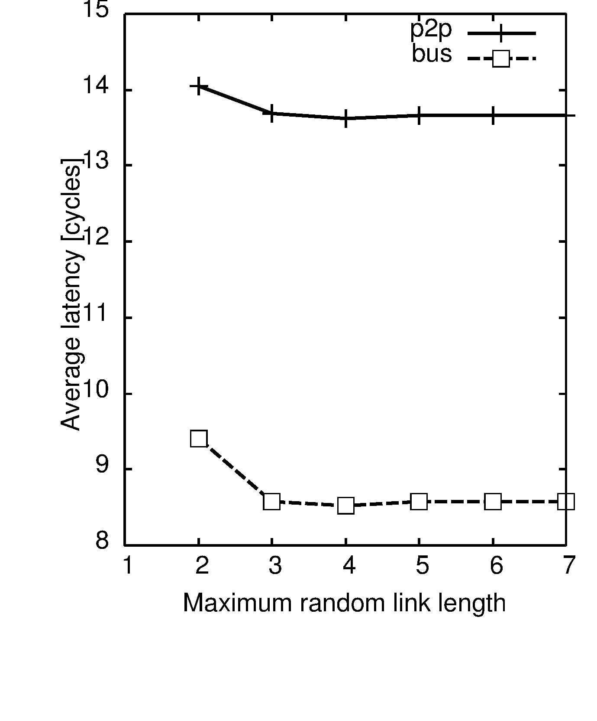
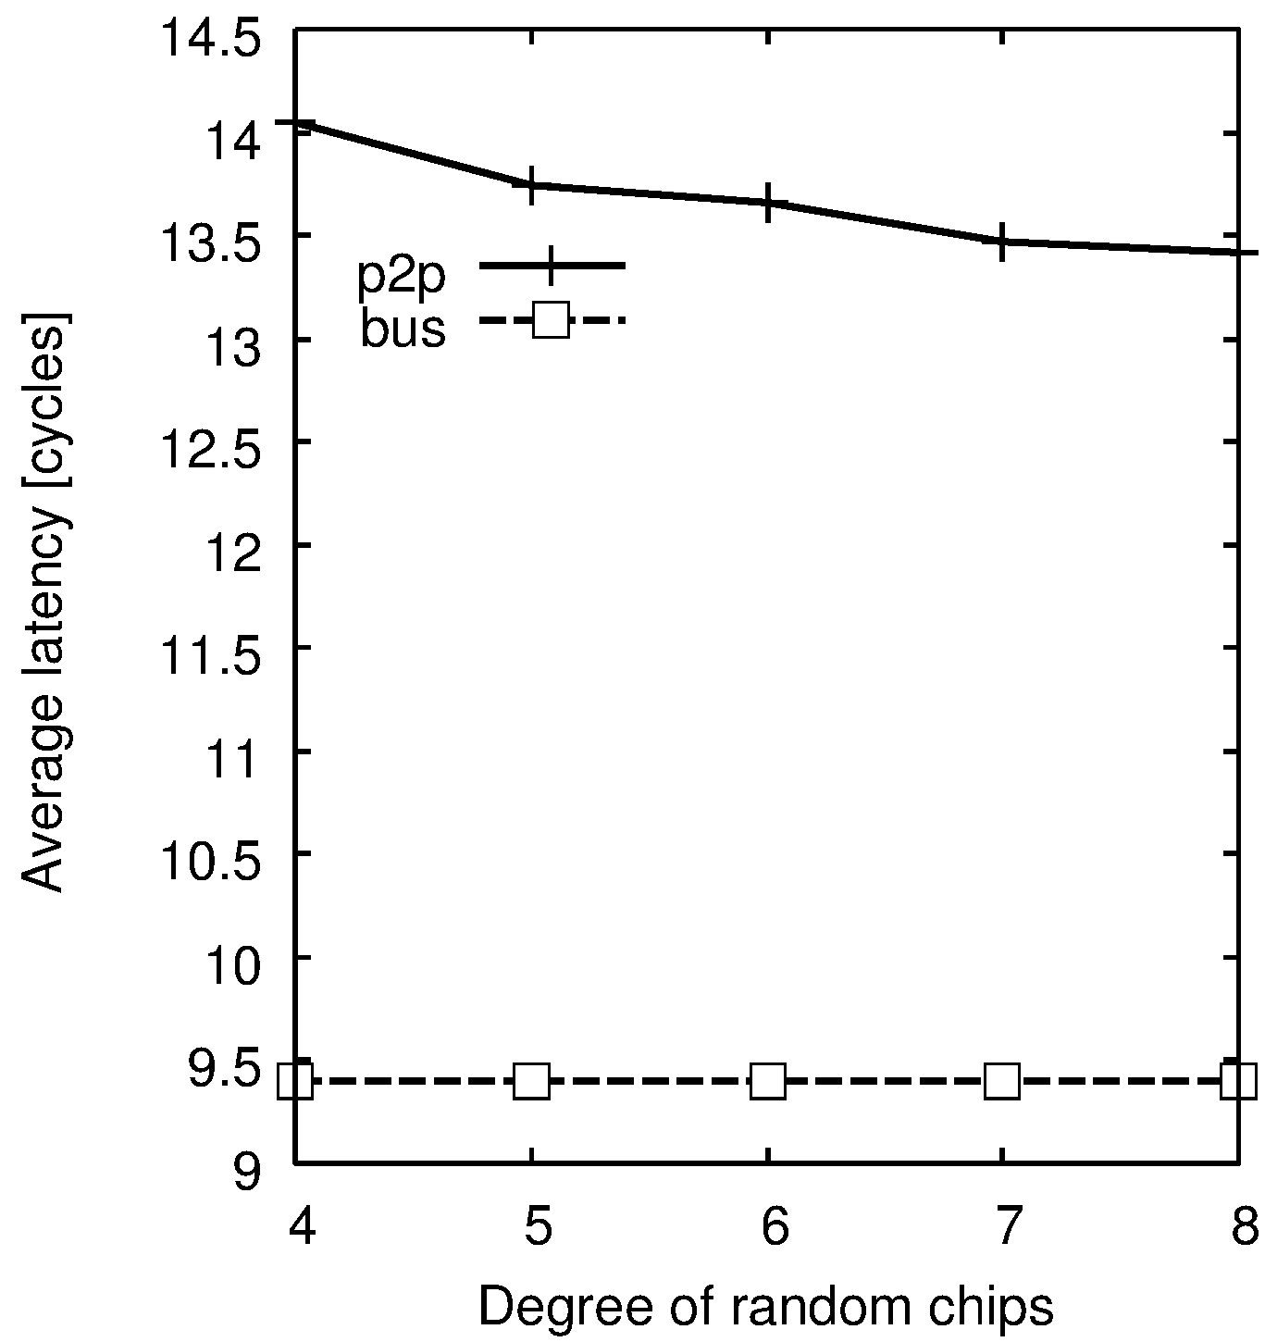

Q2: How should we design random chip?
Max. link length (left) & Horizontal degree (right)
P2P
Bus
P2P
Bus
Double-length link is enough (equivalent to folded torus)
4 ports are enough (equivalent to 2D mesh/torus)
Max random link length [tile]
# of Horizontal router ports

Slide 26
Outline: Random chip for 3D WiNoCs
3D Wireless NoCs (3D WiNoCs) [7min]
  Wireless 3D IC technology
  3D WiNoC design example (65nm)
Adding random NoC chip for 3D WiNoCs [8min]
  Adding randomness induces small-world effects
  Adding random NoC chip to NoC-less 3D ICs
  Replacing regular 2D NoC with random 2D NoC
Design space exploration [5min]
Experiment results and Summary [5min]

Slide 27
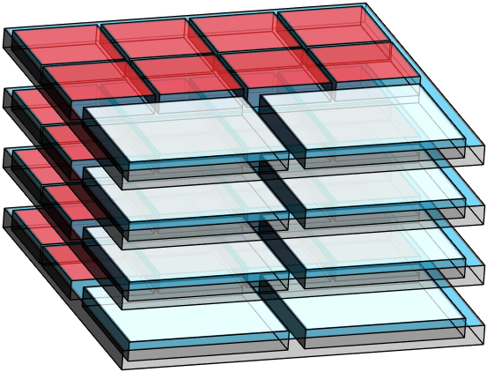
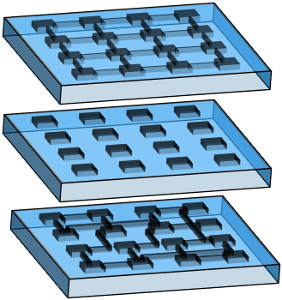
Full-system simulations (gem5)
L2 cache banks
Table 1: Topologies to be examined
m m m m | Mesh | Mesh | Mesh | Mesh | P2P
m r r m | Mesh | Rand | Rand | Mesh | P2P
r r r r | Rand | Rand | Rand | Rand | P2P
- - - r | None | None | None | Rand | Bus
m - - r | Mesh | None | None | Rand | Bus
CPU
CPU
Table 2: Simulation parameters
Processor architecture | X86-64
L1$ size & latency | 32K / 1cycle
L2$ size & latency | 256K / 6cycle
Memory size & latency | 4G / 160cycle
Router latency | [BW] [VSA] [ST] [LT]
Router buffer size | 5-flit per VC
Protocol | MOESI directory (3VC)
m
-
r
Table 3: Application programs
NPB (BT, CG, EP, FT, IS, LU, MG, SP, UA)

Slide 28
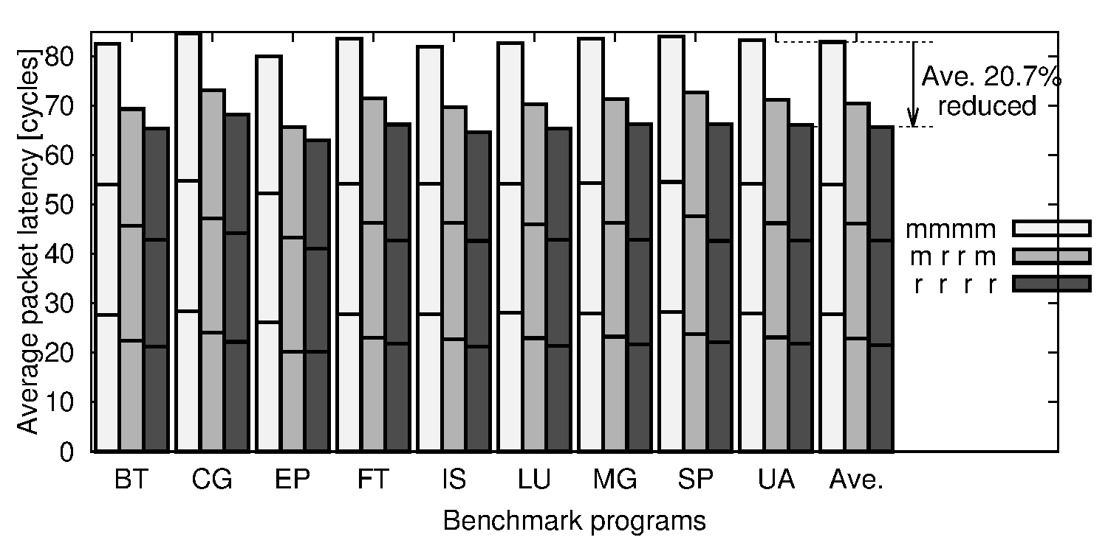
Packet latency: P2P (mmmm mrrm rrrr)
m m m m
m m m m | Mesh | Mesh | Mesh | Mesh | P2P
m r r m | Mesh | Rand | Rand | Mesh | P2P
r r r r | Rand | Rand | Rand | Rand | P2P
- - - m | None | None | None | Mesh | Bus
- - - r | None | None | None | Rand | Bus
m - - r | Mesh | None | None | Rand | Bus
m r r m
r r r r
Average packet latency [cycles]
rrrr reduces latency by 20.7% compared to mmmm

Slide 29
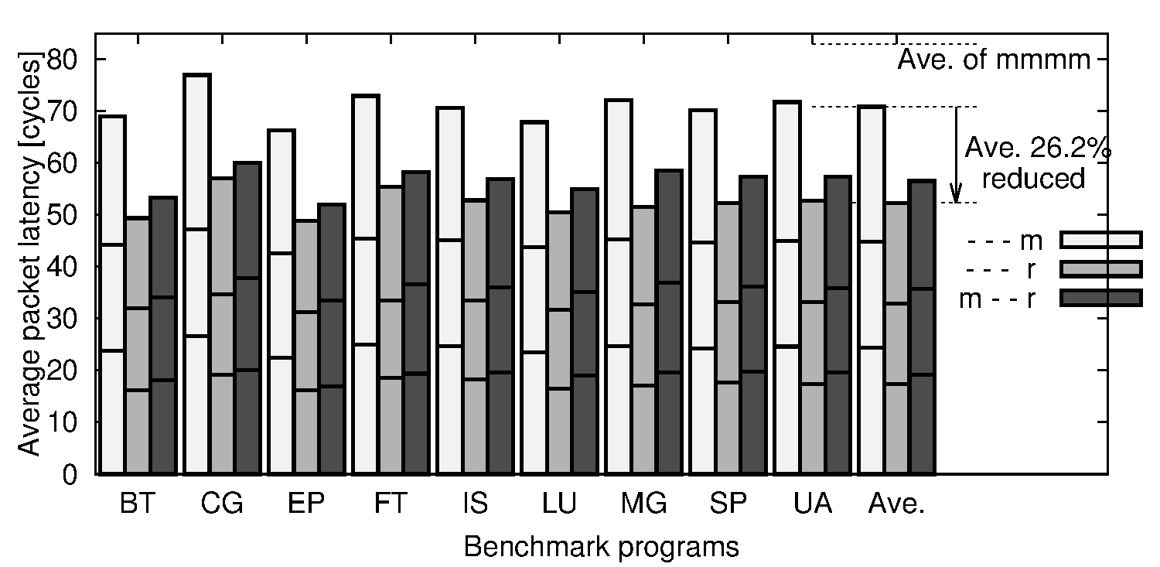
Packet latency: Bus (---m ---r m--r)
- - - m
m m m m | Mesh | Mesh | Mesh | Mesh | P2P
m r r m | Mesh | Rand | Rand | Mesh | P2P
r r r r | Rand | Rand | Rand | Rand | P2P
- - - m | None | None | None | Mesh | Bus
- - - r | None | None | None | Rand | Bus
m - - r | Mesh | None | None | Rand | Bus
- - - r
m - - r
Average packet latency [cycles]
---r reduces latency by 26.2% compared to ---m

Slide 30
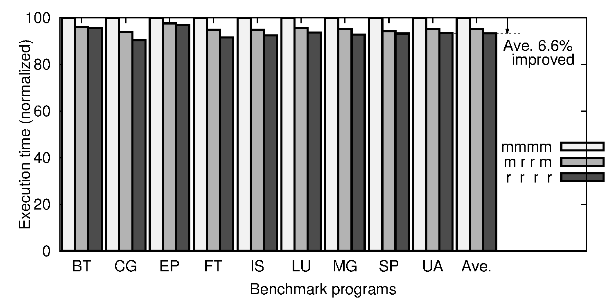
App. exec time: P2P (mmmm mrrm rrrr)
m m m m
m m m m | Mesh | Mesh | Mesh | Mesh | P2P
m r r m | Mesh | Rand | Rand | Mesh | P2P
r r r r | Rand | Rand | Rand | Rand | P2P
- - - m | None | None | None | Mesh | Bus
- - - r | None | None | None | Rand | Bus
m - - r | Mesh | None | None | Rand | Bus
m r r m
r r r r
App execution time (normalized)
rrrr improves exec time by 6.6% compared to mmmm

Slide 31
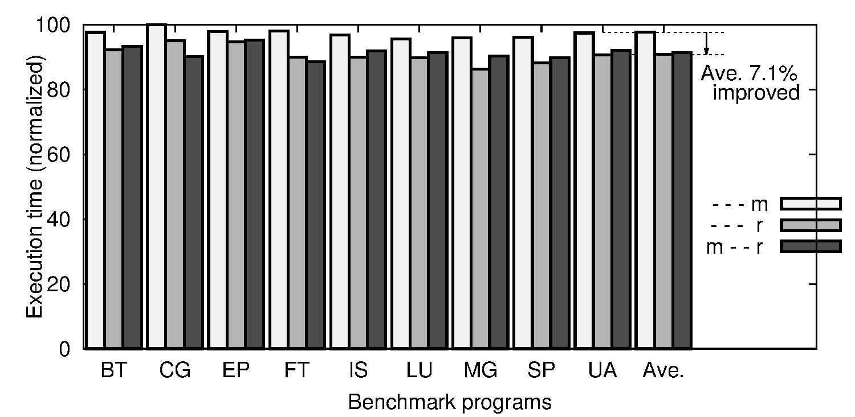
App. exec time: Bus (---m ---r m--r)
- - - m
m m m m | Mesh | Mesh | Mesh | Mesh | P2P
m r r m | Mesh | Rand | Rand | Mesh | P2P
r r r r | Rand | Rand | Rand | Rand | P2P
- - - m | None | None | None | Mesh | Bus
- - - r | None | None | None | Rand | Bus
m - - r | Mesh | None | None | Rand | Bus
- - - r
m - - r
App execution time (normalized)
---r improves exec time by 7.1% compared to ---m

Slide 32
Summary: Random NoC to 3D WiNoCs
3D Wireless NoC (3D WiNoC)
  We can add necessary chips to build custom SiP
  Example: Cube-1 (1 CPU chip + 3 Accelerator chips)
  → Adding randomness induces small-world effect
Two case studies
  Adding random NoC chip to NoC-less 3D ICs
  Replacing regular 2D NoC with random 2D NoC
Reasonable solution
  Adding one or two random chips is enough
  Horizontal degree = 4; Max random link length = 2
Experimental results
  Packet latency is improved by 26.2%
  Application execution time is reduced accordingly

Slide 33
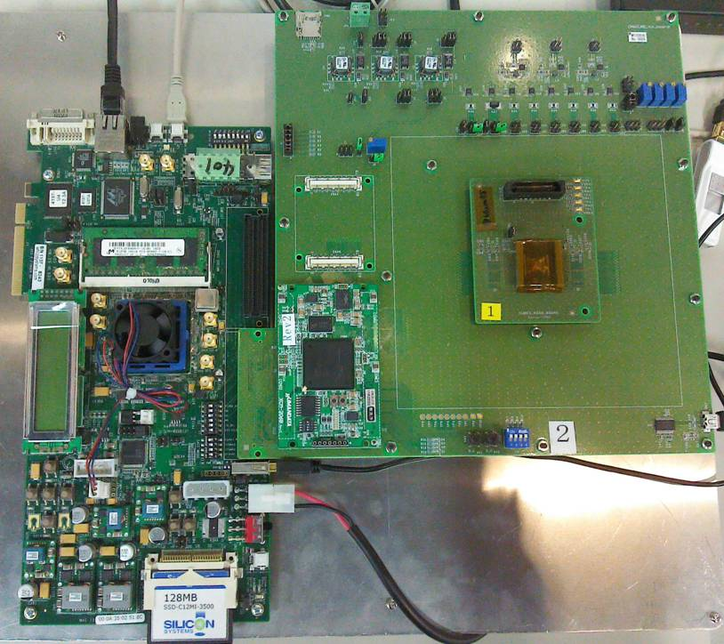
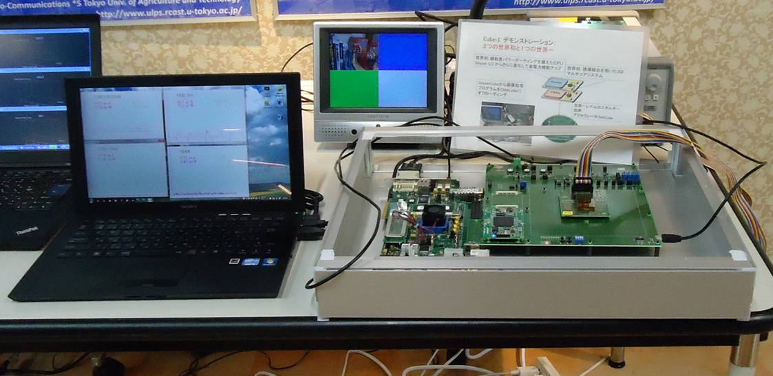
Thank you for listening!
Cube-1 demo system
PE array chip performs image processing;
CPU chip for control
Cube-1
[Miura, HotChips’13 Demo]
Motherboard
33

Slide 34
Backup slides

