Slide 1
Ultra Fine-Grained Run-Time Power Gating of On-Chip Routers for CMPs
Hiroki Matsutani
Michihiro Koibuchi
Daisuke Ikebuchi
Kimiyoshi Usami
Hiroshi Nakamura
Hideharu Amano
(Univ Tokyo, Japan)
(NII, Japan)
(Keio Univ, Japan)
(Shibaura IT, Japan)
(Univ Tokyo, Japan)
(Keio Univ, Japan)

Slide 2
Multi-Core & Many-Core
picoChip PC102
picoChip PC205
256
ClearSpeed CSX700
128
ClearSpeed CSX600
Intel 80-core
64
TILERA TILE64
32
MIT RAW
UT TRIPS (OPN)
Number of PEs (caches are not included)
16
STI Cell BE
8
Sun T1
Sun T2
4
Intel Core, IBM Power7
AMD Opteron
2
2002
2004
2006
2008
2010?

Slide 3
Multi-Core & Many-Core
picoChip PC102
picoChip PC205
256
ClearSpeed CSX700
128
Hundreds of simple PEs
ClearSpeed CSX600
Intel 80-core
64
TILERA TILE64
Target
32
MIT RAW
UT TRIPS (OPN)
Number of PEs (caches are not included)
16
STI Cell BE
Chip multi-
processor (CMP)
8
Sun T1
Sun T2
4
Intel Core, IBM Power7
AMD Opteron
2
2002
2004
2006
2008
2010?

Slide 4
Our target: NoC for future CMPs
8-CPU CMP example
8 CPUs (each has a private L1 cache)
Shared L2 cache (divided into 64 banks)
[Beckmann, MICRO’04]
UltraSPARC
L1 cache (I & D)
(16kB)
L2 cache bank
(256kB, 4-way)

Slide 5
Our target: NoC for future CMPs
8-CPU CMP example
8 CPUs (each has a private L1 cache)
Shared L2 cache (divided into 64 banks)
CPUs and cache banks are interconnected via NoC
On-chip network is an infrastructure of CMPs.
It must be always ready for the packet transfers.
→ It consumes leakage power at any time!
Run-time power gating that stops the power supply to the routers whenever possible is required.
[Beckmann, MICRO’04]
UltraSPARC
L1 cache (I & D)
(16kB)
L2 cache bank
(256kB, 4-way)
On-chip router

Slide 6
Outline: Fine-grain power gating router
Fine-grained power gating router
Input VC buffers
Crossbar MUXes, VC MUXes
Output latches
Power domain implementation @ 65nm
Design flow
Wakeup latency estimation and its impact
Three early wakeup methods
Evaluation results
Application performance w/ early wakeup
Leakage power reduction
35 power domains
in each router

Slide 7
Power gating: Coarse- vs. fine-grain
Coarse-grain approach
IP core (module) level
Surrounded by VGND
Power switch between VGND and GND
Fine-grain approach
Standard cell level
Each cell has VGND port
All cells in a domain share the same VGND line
[Usami, ICCD’06]
Virtual GND (VGND)
IP Core
IP Core
IP Core
IP Core
IP Core
IP Core
IP Core
IP Core
On/Off
PowerSwitch
GND ring

Slide 8
Power gating: Coarse- vs. fine-grain
Coarse-grain approach
IP core (module) level
Surrounded by VGND
Power switch between VGND and GND
Fine-grain approach
Standard cell level
Each cell has VGND port
All cells in a domain share the same VGND line
[Usami, ICCD’06]
VDD
PowerSwitch
VDD
VDD
Virtual GND (VGND)
OR
OR
OR
AND
AND
AND
On/Off
GND
GND
IP Core
GND
IP Core
VGND
GND
GND
GND
On/Off
PowerSwitch
INV
INV
INV
DFF
DFF
DFF
GND ring
VDD
VDD
VDD

Slide 9
Which is better? Coarse or Fine
Each router component (e.g., input port) works independently each other
Fine-grain approach has more opportunities to sleep
ARBITER
X+
X+
Packet#1
X-
X-
Y+
Y+
Packet#2
Y-
Y-
5x5 CROSSBAR
CORE
CORE

Slide 10
Fine-grain run-time PG router
Router is divided into many Micro-power-domains
Input VC buffers, Output latches
Crossbar MUXes, VC MUXes
35 power domains
in a 5-port router
ARBITER
X+
X+
X-
X-
Y+
Y+
Y-
Y-
5x5 CROSSBAR
CORE
CORE

Slide 11
Fine-grain run-time PG router
Router is divided into many Micro-power-domains
Input VC buffers, Output latches
Crossbar MUXes, VC MUXes
35 power domains
in a 5-port router
ARBITER
X+
X+
Packet
X-
X-
Y+
Y+
Y-
Y-
5x5 CROSSBAR
CORE
CORE

Slide 12
Fine-grain run-time PG router
Router is divided into many Micro-power-domains
Input VC buffers, Output latches
Crossbar MUXes, VC MUXes
35 power domains
in a 5-port router
ARBITER
X+
X+
X-
X-
Y+
Y+
Y-
Y-
5x5 CROSSBAR
CORE
CORE

Slide 13
Fine-grain run-time PG router
Router is divided into many Micro-power-domains
Input VC buffers, Output latches
Crossbar MUXes, VC MUXes
35 power domains
in a 5-port router
ARBITER
X+
X+
X-
X-
Y+
Y+
Y-
Y-
5x5 CROSSBAR
CORE
CORE

Slide 14
Fine-grain run-time PG router
Router is divided into many Micro-power-domains
Input VC buffers, Output latches
Crossbar MUXes, VC MUXes
35 power domains
in a 5-port router
ARBITER
X+
X+
X-
X-
Y+
Y+
Y-
Y-
5x5 CROSSBAR
CORE
CORE

Slide 15
Fine-grain run-time PG router
Router is divided into many Micro-power-domains
Input VC buffers, Output latches
Crossbar MUXes, VC MUXes
35 power domains
in a 5-port router
ARBITER
X+
X+
X-
X-
Y+
Y+
Y-
Y-
5x5 CROSSBAR
CORE
CORE
Each power domain is activated only when it is “really” used

Slide 16
Outline: Fine-grain power gating router
Fine-grained power gating router
Input VC buffers
Crossbar MUXes, VC MUXes
Output latches
Power domain implementation @ 65nm
Design flow
Wakeup latency estimation and its impact
Three early wakeup methods
Evaluation results
Application performance w/ early wakeup
Leakage power reduction
35 power domains
in each router

Slide 17
Power domain design: Design flow
Verilog netlist
HOLD cell insertion not to propagate “X”
Place-and-route
Power switch insertion
Place-and-route again
RC extraction
SPICE simulation
Synopsys DesignCompiler
module FIFO (in, out);
input [127:0] in;
output [127:0] out:
DFF reg0 (in0, out0, clk);
DFF reg1 (in1, out1, clk);
endmodule
By hand
Synopsys Astro
Sequence Design CoolPower
Synopsys Astro
Cadence Assura (QRC)
Synopsys HSIM

Slide 18
Power domain design: Design flow
Verilog netlist
HOLD cell insertion not to propagate “X”
Place-and-route
Power switch insertion
Place-and-route again
RC extraction
SPICE simulation
Synopsys DesignCompiler
module FIFO (in, out);
input [127:0] in;
output [127:0] out:
DFF reg0 (in0, out0, clk);
DFF reg1 (in1, out1, clk);
HOLD (out0);
HOLD (out1);
endmodule
By hand
Synopsys Astro
Sequence Design CoolPower
Synopsys Astro
Cadence Assura (QRC)
Synopsys HSIM

Slide 19
Power domain design: Design flow
Verilog netlist
HOLD cell insertion not to propagate “X”
Place-and-route
Power switch insertion
Place-and-route again
RC extraction
SPICE simulation
Synopsys DesignCompiler
VDD
By hand
OR
AND
DFF
GND
Synopsys Astro
GND
Sequence Design CoolPower
INV
DFF
AND
OR
NOR
Synopsys Astro
VDD
Cadence Assura (QRC)
Domain#0
Domain#1
Synopsys HSIM

Slide 20
Power domain design: Design flow
PowerSwitch
Verilog netlist
HOLD cell insertion not to propagate “X”
Place-and-route
Power switch insertion
Place-and-route again
RC extraction
SPICE simulation
Synopsys DesignCompiler
VDD
By hand
OR
AND
DFF
GND
Synopsys Astro
VGND
GND
Sequence Design CoolPower
INV
DFF
AND
OR
NOR
Synopsys Astro
VDD
Cadence Assura (QRC)
Domain#0
Domain#1
Area overhead:
Power switch and hold cells: 4.3%
But, we need larger cells: 15.9% in total
Synopsys HSIM

Slide 21
Power domain design: Design flow
Verilog netlist
HOLD cell insertion not to propagate “X”
Place-and-route
Power switch insertion
Place-and-route again
RC extraction
SPICE simulation
Synopsys DesignCompiler
On/Off control
Power On when packet comes
Power Off when packet leaves
By hand
Input VC buffer
Synopsys Astro
VDD
Sequence Design CoolPower
FIFO
Synopsys Astro
Cadence Assura (QRC)
GND
Synopsys HSIM

Slide 22
Power domain design: Design flow
Verilog netlist
HOLD cell insertion not to propagate “X”
Place-and-route
Power switch insertion
Place-and-route again
RC extraction
SPICE simulation
Synopsys DesignCompiler
On/Off control
Power On when packet comes
Power Off when packet leaves
By hand
Input VC buffer
Synopsys Astro
VDD
Sequence Design CoolPower
FIFO
FIFO
Synopsys Astro
VGND
Wakeup
Switch
Cadence Assura (QRC)
GND
Synopsys HSIM

Slide 23
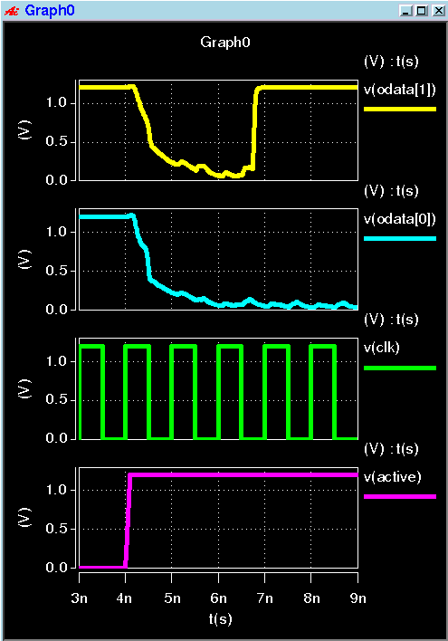
Power domain design: Design flow
Correct output
FIFO
OUT[1]
Verilog netlist
HOLD cell insertion not to propagate “X”
Place-and-route
Power switch insertion
Place-and-route again
RC extraction
SPICE simulation
On/Off control
Power On when packet comes
Power Off when packet leaves
2.8nsec
FIFO
OUT[0]
Wakeup &
Initialization
Input VC buffer
CLOCK
VDD
FIFO
FIFO
WAKEUP
VGND
Power ON
Wakeup
Switch
GND
Fujitsu 65nm CMOS (1.20V, 75C)

Slide 24
Power domain design: Design flow
Verilog netlist
HOLD cell insertion not to propagate “X”
Place-and-route
Power switch insertion
Place-and-route again
RC extraction
SPICE simulation
Synopsys DesignCompiler
On/Off control
Power On when packet comes
Power Off when packet leaves
By hand
Crossbar multiplexer
Synopsys Astro
VDD
Sequence Design CoolPower
MUX
MUX
Synopsys Astro
VGND
Wakeup
Switch
Cadence Assura (QRC)
GND
Synopsys HSIM

Slide 25
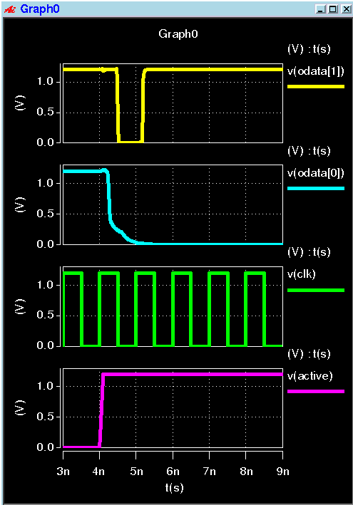
Power domain design: Design flow
Correct output
MUX
OUT[1]
Verilog netlist
HOLD cell insertion not to propagate “X”
Place-and-route
Power switch insertion
Place-and-route again
RC extraction
SPICE simulation
On/Off control
Power On when packet comes
Power Off when packet leaves
1.3nsec
MUX
OUT[0]
Wakeup
Crossbar multiplexer
CLOCK
VDD
MUX
MUX
WAKEUP
VGND
Power ON
Wakeup
Switch
GND
CORE
All power domains in this router can be activated within 3nsec
Fujitsu 65nm CMOS (1.20V, 75C)

Slide 26
Wakeup latency impact on CMPs
Full system CMP simulator: GEMS/Simics
3-cycle router
Wakeup latencies: 2, 3, 4 cycles
SPLASH-2 benchmark (8 threads)
[Martin,CAN’05]
[RC] [VSA] [ST]
radix, lu, fft, barnes, ocean, raytrace, volrend, water-ns, water-sp, fmm (10 applications)
UltraSPARC
L1 cache (I & D)
(16kB)
L2 cache bank
(256kB, 4-way)
On-chip router

Slide 27
Wakeup latency impact on CMPs
Full system CMP simulator: GEMS/Simics
3-cycle router
Wakeup latencies: 2, 3, 4 cycles
SPLASH-2 benchmark (8 threads)
[Martin,CAN’05]
[RC] [VSA] [ST]
radix, lu, fft, barnes, ocean, raytrace, volrend, water-ns, water-sp, fmm (10 applications)
Token coherence protocol
[Martin,ISCA’03]
VC0
Request msg (L1 L2)
VC1
Request msg (L2 Mem)
VC2
Reply msg (All All)
VC3
Persistent request msg

Slide 28
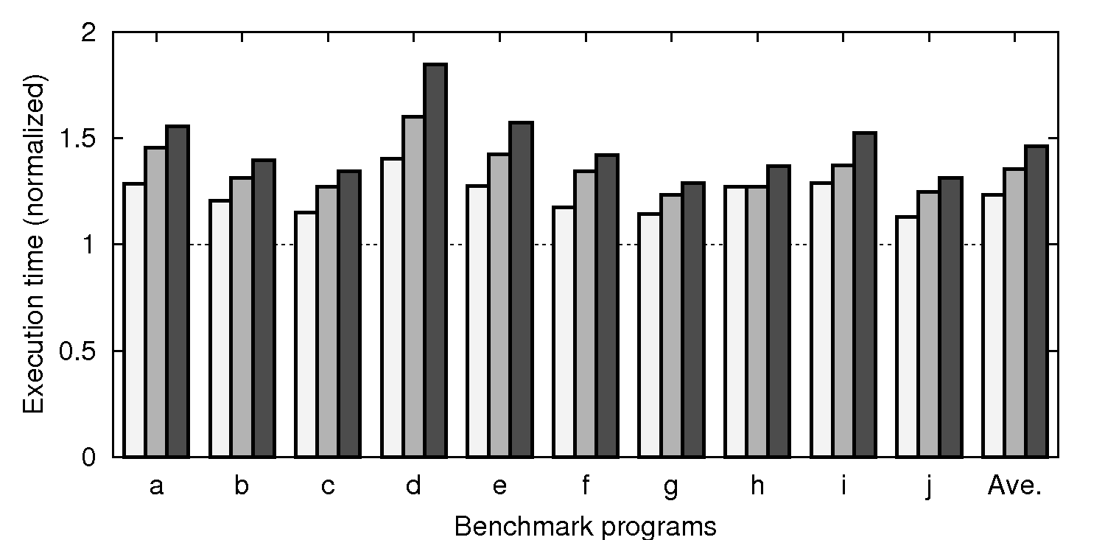
Wakeup latency impact: Results
Execution times of SPLASH-2 (10 applications)
2-cycle wait
3-cycle wait
4-cycle wait
(@667MHz)
(@1000MHz)
(@1333MHz)
Execution time w/o power gating = 1.00
Execution time increases 23.2-46.3% (unacceptable!)
Radix
Lu
Fft
Barnes
Ocean
Ray-
Vol-
Water
Water
Fmm
Ave
Longer execution consumes more power; Early wakeup required
trace
rend
NS
SP

Slide 29
Outline: Fine-grain power gating router
Fine-grained power gating router
Input VC buffers
Crossbar MUXes, VC MUXes
Output latches
Power domain implementation @ 65nm
Design flow
Wakeup latency estimation and its impact
Three early wakeup methods
Evaluation results
Application performance w/ early wakeup
Leakage power reduction
35 power domains
in each router

Slide 30
Early wakeup: Look-ahead method
Router modules in 2-hop away activated in advance
Look-ahead routing is used
Wakeup procedure starts 4-cycle in advance
Problems
Wakeup signals span 2-hop
Cannot wakeup the 1-hop
router in advance
[Matsutani, ASPDAC’08]
SRC
DST
Wakeup
Wakeup
1-hop
2-hop
3-hop
4-hop
(*) Average hop is 2.67 @ 4x4 mesh
Suffers first-hop wakeup latency; Small benefit of look-ahead

Slide 31
Early wakeup: Look-ahead method
+ CPU ever-on
Router modules in 2-hop away activated in advance
Look-ahead routing is used
Wakeup procedure starts 4-cycle in advance
Ever-on domain
VC buffers connected
from CPU are always active
No wait for the first-hop
But, they consume leakage
SRC
DST
Wakeup
Wakeup
Ever-on
1-hop
2-hop
3-hop
4-hop

Slide 32
Early wakeup: Look-ahead method
+ CPU ever-on
Router modules in 2-hop away activated in advance
Look-ahead routing is used
Wakeup procedure starts 4-cycle in advance
Ever-on domain
VC0 and VC2 connected
from CPU are always active
No wait for the first-hop
SRC
DST
Wakeup
Wakeup
Ever-on
VC0
Request msg (L1 L2)
VC1
Request msg (L2 Mem)
VC2
Reply msg (All All)
VC3
Persistent request msg
1-hop
2-hop
3-hop
4-hop
(*) VC0 and VC2 are heavily loaded
Ever-on domain is only 4.7%; Minimum leakage power overhead

Slide 33
Early wakeup: Active buffer window
Active buffer window in each VC buffer
A part of the buffer is always activated
Active buffer window shifts when it receives/sends flit
Short packets (less than window size) → No wait
[Chen,ISLPED’03]
ARBITER
X+
Window size = 3
X-
Y+
Y+
Y-
5x5 CROSSBAR
Read
CORE
Write

Slide 34
Early wakeup: Active buffer window
Active buffer window in each VC buffer
A part of the buffer is always activated
Active buffer window shifts when it receives/sends flit
Short packets (less than window size) → No wait
[Chen,ISLPED’03]
ARBITER
X+
Window size = 3
X-
Y+
Y+
Y-
5x5 CROSSBAR
Read
CORE
Write

Slide 35
Early wakeup: Active buffer window
Active buffer window in each VC buffer
A part of the buffer is always activated
Active buffer window shifts when it receives/sends flit
Short packets (less than window size) → No wait
[Chen,ISLPED’03]
ARBITER
X+
Window size = 3
X-
Y+
Y+
Y-
5x5 CROSSBAR
Read
CORE
Write

Slide 36
Early wakeup: Active buffer window
Active buffer window in each VC buffer
A part of the buffer is always activated
Active buffer window shifts when it receives/sends flit
Short packets (less than window size) → No wait
[Chen,ISLPED’03]
ARBITER
X+
Window size = 3
X-
Y+
Y+
Y-
5x5 CROSSBAR
Read
CORE
Write

Slide 37
Early wakeup: Active buffer window
Active buffer window in each VC buffer
A part of the buffer is always activated
Active buffer window shifts when it receives/sends flit
Short packets (less than window size) → No wait
[Chen,ISLPED’03]
ARBITER
X+
Window size = 3
X-
Y+
Y+
Y-
5x5 CROSSBAR
Read
CORE
No wait, but the window consumes leakage →Small PG benefit
Write

Slide 38
Outline: Fine-grain power gating router
Fine-grained power gating router
Input VC buffers
Crossbar MUXes, VC MUXes
Output latches
Power domain implementation @ 65nm
Design flow
Wakeup latency estimation and its impact
Three early wakeup methods
Evaluation results
Application performance w/ early wakeup
Leakage power reduction
35 power domains
in each router

Slide 39
CMP simulator: GEMS/Simics
[Martin,CAN’05]
Full system CMP simulation
8 CPUs, 64 L2 banks, 4x4 mesh
Sun Solaris 9; Sun Studio 12
SPLASH-2 benchmark (8 threads)
radix, lu, fft, barnes, ocean, raytrace, volrend, water-ns, water-sp, fmm (10 applications)
UltraSPARC
L1 cache (I & D)
(16kB)
L2 cache bank
(256kB, 4-way)
On-chip router

Slide 40
CMP simulator: GEMS/Simics
[Martin,CAN’05]
Full system CMP simulation
8 CPUs, 64 L2 banks, 4x4 mesh
Sun Solaris 9; Sun Studio 12
SPLASH-2 benchmark (8 threads)
radix, lu, fft, barnes, ocean, raytrace, volrend, water-ns, water-sp, fmm (10 applications)
Token coherence protocol
[Martin,ISCA’03]
VC0
Request msg (L1 L2)
VC1
Request msg (L2 Mem)
VC2
Reply msg (All All)
VC3
Persistent request msg

Slide 41
CMP simulator: GEMS/Simics
Full system CMP simulation
8 CPUs, 64 L2 banks, 4x4 mesh
Sun Solaris 9; Sun Studio 12
SPLASH-2 benchmark (8 threads)
Three early wakeup methods are compared
Wakeup latency: 3nsec (3-cycle wakeup @ 1GHz)
radix, lu, fft, barnes, ocean, raytrace, volrend, water-ns, water-sp, fmm (10 applications)
Window size = 2
SRC
DST
SRC
DST
Wakeup
Wakeup
Read
Ever-on
Write
Look-ahead
Look-ahead +CPU ever-on
Buffer window

Slide 42
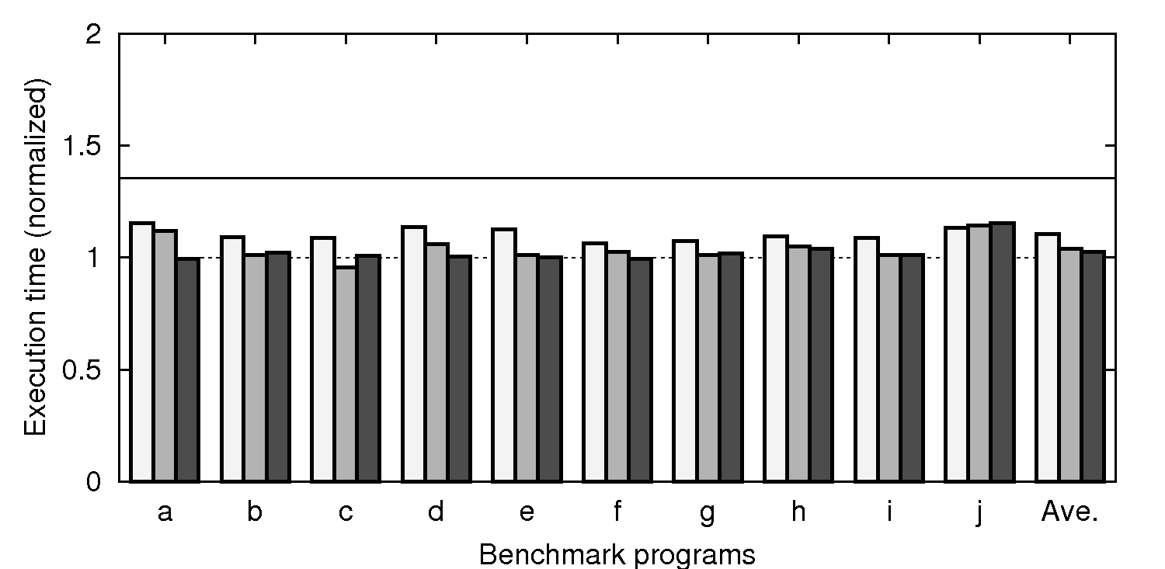
Evaluations: Application performance
Execution times of SPLASH-2 (3-cycle wakeup @ 1GHz)
Look-ahead with
Look-ahead
Buffer window
CPU ever-on
(1.00 = Execution time with no wakeup latency)
Execution time without early wakeup (+35.3%)
Performance overhead is only 4.0% (CPU-ever on)
Radix
Lu
Fft
Barnes
Ocean
Ray-
Vol-
Water
Water
Fmm
Ave
Early wakeup significantly mitigates the performance overhead
trace
rend
NS
SP

Slide 43
Evaluations: Leakage power reduction
SRC
DST
SRC
DST
Window size = 2
Wakeup
Wakeup
Read
Ever-on
Write
Look-ahead
Look-ahead +CPU ever-on
Buffer window
Power gating is applied to the router with 3 steps
Level-1 power gating
Level-2 power gating
Level-3 power gating
ARB
ARB
ARB
Input buffer only
Input buffer + Xbar
In/output buffer + Xbar

Slide 44
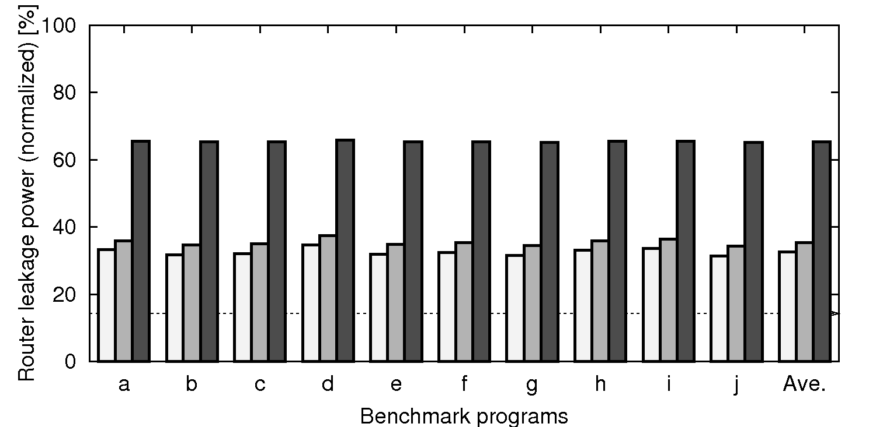
Evaluations: Leakage power reduction
Level-1 PG: Input buffer only (3-cycle wakeup)
Look-ahead with
Look-ahead
Buffer window
CPU ever-on
Leakage power without power gating (100%)
Input buffer PG reduces the leakage power by
64.6% when applications are running @ 1GHz
Radix
Lu
Fft
Barnes
Ocean
Ray-
Vol-
Water
Water
Fmm
Ave
trace
rend
NS
SP

Slide 45
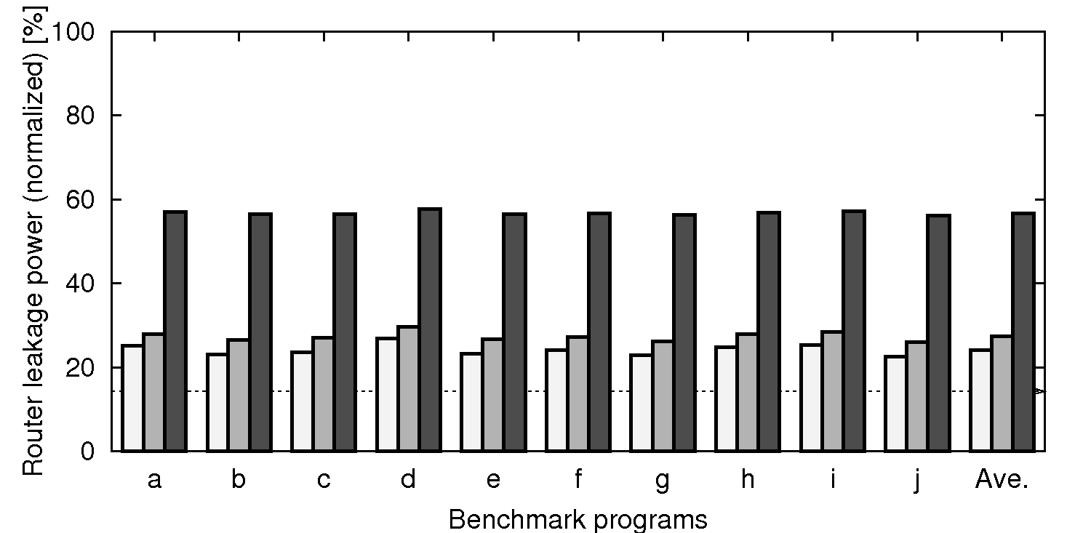
Evaluations: Leakage power reduction
Level-2 PG: Input buffer + Crossbar (3-cycle wakeup)
Look-ahead with
Look-ahead
Buffer window
CPU ever-on
Leakage power without power gating (100%)
Input buffer PG + Crossbar PG reduce the leakage power by 72.7% @ 1GHz
Radix
Lu
Fft
Barnes
Ocean
Ray-
Vol-
Water
Water
Fmm
Ave
trace
rend
NS
SP

Slide 46
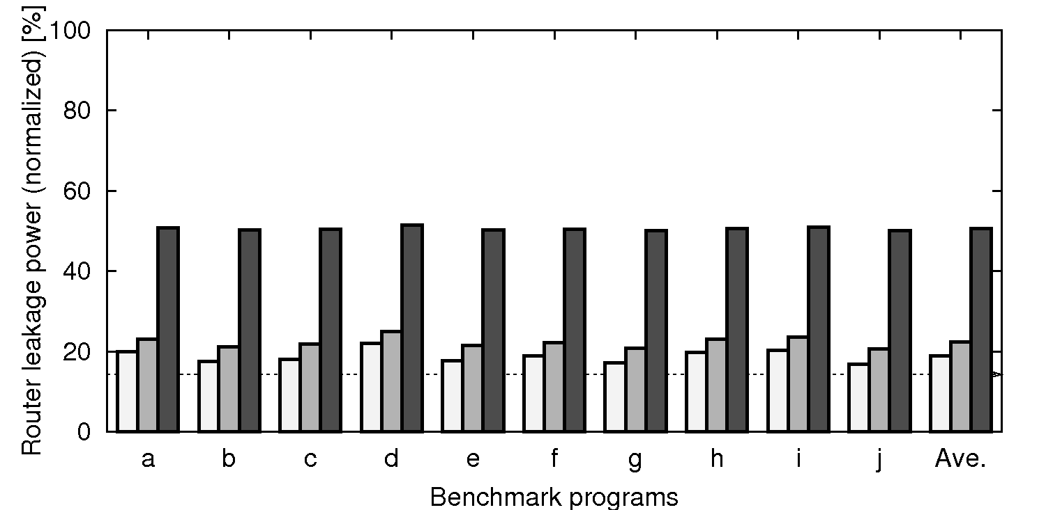
Evaluations: Leakage power reduction
Level-3 PG: Input buffer + Crossbar + Output latch
Look-ahead with
Look-ahead
Buffer window
CPU ever-on
Leakage power without power gating (100%)
Input buffer PG + Crossbar PG + Output latch PG reduce the leakage power by 77.7% @ 1GHz
Radix
Lu
Fft
Barnes
Ocean
Ray-
Vol-
Water
Water
Fmm
Ave
Fine-grain PG with early wakeup reduces the leakage by 77.7%
trace
rend
NS
SP

Slide 47
Summary: Run-time PG router for CMPs
Power gating for router components
Input VC buffers
Crossbar MUXes, VC MUXes
Output latches
Wakeup latency is at most 3nsec
Three early wakeup methods
Look-ahead
Look-ahead with CPU ever-on
Look-ahead with active buffer window
Evaluation results
Performance overhead is less than 4.0% @ 1GHz
Leakage power is reduced by 77.7%
35 power domains
in each router

Slide 48
Thank you for your attention

