Slide 1
A Vertical Bubble Flow Network using Inductive-Coupling for 3D CMPs
Hiroki Matsutani¹, Yasuhiro Take², Daisuke Sasaki²,
Masayuki Kimura², Yuki Ono², Yukinori Nishiyama²,
Michihiro Koibuchi³, Tadahiro Kuroda², Hideharu Amano²
1) The University of Tokyo, 2) Keio University,
3) National Institute of Informatics

Slide 2
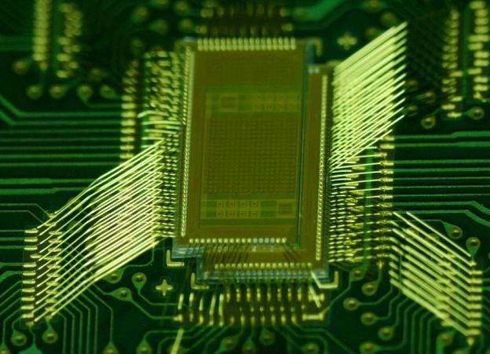
Outline: Wireless 3D NoC for CMPs
3D IC technologies
Wired approach vs. wireless approach
Inductive-coupling technology
Our target: Wireless 3D CMPs
Type and number of chips stacked in a package can be customized for given applications
Simple wireless 3D NoC
Ring-based 3D network
Bubble flow control
Experimental results
Real chip implementation
Full-system simulation results

Slide 3
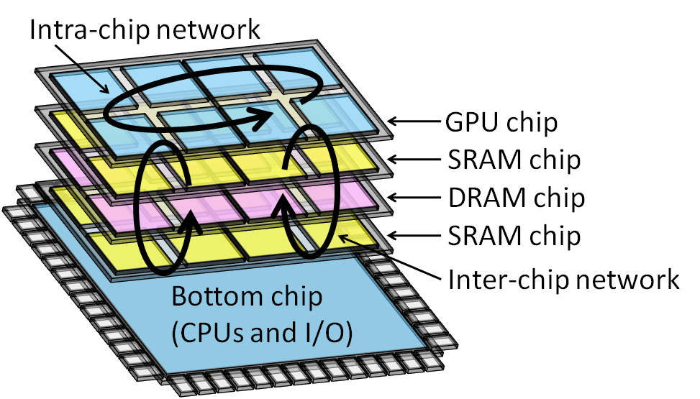
Design cost of LSI is increasing
System-on-Chip (SoC)
Required components are integrated on a single chip
Different LSI must be developed for each application
System-in-Package (SiP) or 3D IC
Required components are stacked for each application
By changing the chips in a package, we can provide a wider range of chip family with modest design cost

Slide 4
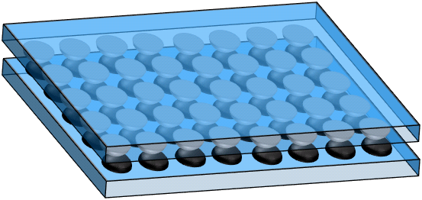
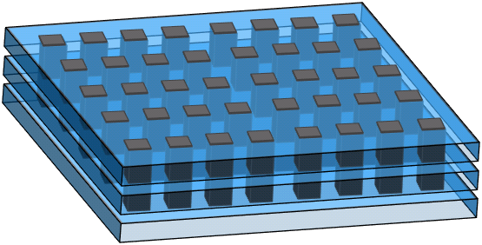
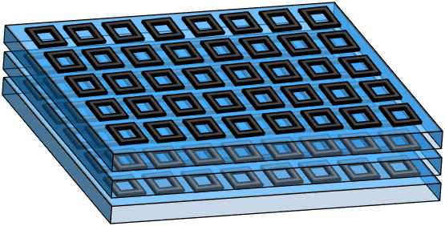
3D IC technology for going vertical
Wired
Wireless
Two chips (face-to-face)
Flexibility
Microbump
Capacitive coupling
Scalability
More than three chips
Through silicon via
Inductive coupling

Slide 5
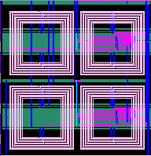
Inductive coupling link for 3D ICs
Stacking after chip fabrication
Only know-good-dies selected
Bonding wires for power supply
More than 3 chips
Inductor for transceiver
Footprint of inductor
Implemented as a square coil with metal in common CMOS
Not a serious problem. Only
metal layers are occupied

Slide 6
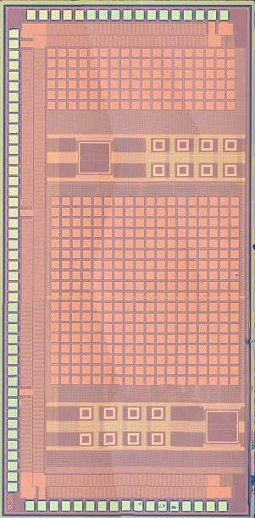
An example: MuCCRA-Cube (2008)
4 MuCCRA chips are stacked on a PCB board
Data Memory
Inductive-Coupling Down Link
PE
PE
PE
PE
5.0mm
PE
PE
PE
PE
PE
PE
PE
PE
PE
PE
PE
PE
Inductive-Coupling Up Link
2.5mm
Technology: 90nm, Chip thickness: 85um, Glue: 10um
[Saito,FPL’09]

Slide 7
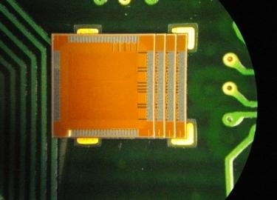
Chip stacking method: Slide & stack
Inductor has TX/RX/Idle modes (1-cycle switch)
Bonding wire
TX
TX
Slide & stack
Bonding wire
TX
TX
Bonding wire
TX
Inductor (TX)
TX
TX
Inductor (RX)
Bonding wire
TX
TX

Slide 8
Chip stacking method: Slide & stack
Inductive-coupling link
Local clock line @ 4GHz
Serial data line
System clock for NoC is 200MHz
→ 32-bit transfer for each clock
Today’s talk is the wireless 3D CMP that connects processors & caches using this wireless technology
Bonding wire
TX
TX
TxData
TxClk
TxData
TxClk
Bonding wire
TX
TX
TxData
TxClk
TxData
TxClk
Bonding wire
TX
Inductor (TX)
TX
TX
TxData
TxClk
TxData
TxClk
Inductor (RX)
Bonding wire
TX
TX
Local clock is shared by neighboring chips; No global sync.

Slide 9
Outline: Wireless 3D NoC for CMPs
3D IC technologies
Wired approach vs. wireless approach
Inductive-coupling technology
Our target: Wireless 3D CMPs
Type and number of chips stacked in a package can be customized for given applications
Simple wireless 3D NoC
Ring-based 3D network
Bubble flow control
Experimental results
Real chip implementation
Full-system simulation results

Slide 10
Our target: Original 2D CMPs
Chip multi processor (CMP)
Multiple processors (each has private L1 cache)
Shared L2 cache divided into multiple banks (SNUCA)
Processor tile
Cache tile
UltraSPARC
L1 cache (I & D)
L2 cache bank

Slide 11
Our target: Original 2D CMPs
Chip multi processor (CMP)
Multiple processors (each has private L1 cache)
Shared L2 cache divided into multiple banks (SNUCA)
Processors and L2 banks are connected via NoC
UltraSPARC
L1 cache (I & D)
L2 cache bank
On-chip router

Slide 12
Wireless 3D CMP: Homogeneous
E.g., 2D is divided into 8 planes
Stacking the same chips
Chip 7
Chip 2
Chip 1
Chip 0

Slide 13
Wireless 3D CMP: Heterogeneous
Types and number of chips are customized for applications
For memory-bound applications,
More cache chips are added
For computation-bound applications,
More processor chips are added
Chip 7
Chip 2
Chip 1
Chip 0
Chips should be added, removed, swapped for given application

Slide 14
Outline: Wireless 3D NoC for CMPs
3D IC technologies
Wired approach vs. wireless approach
Inductive-coupling technology
Our target: Wireless 3D CMPs
Type and number of chips stacked in a package can be customized for given applications
Simple wireless 3D NoC
Ring-based 3D network
Bubble flow control
Experimental results
Real chip implementation
Full-system simulation results

Slide 15
Big picture: Wireless 3D NoC for CMPs
Arbitrary chips are stacked to form a single system
Each chip has vertical links at pre-specified locations, but we do not know the number and types of chips.
Memory chip from
memory maker
Required chips are stacked for given applications
GPU chip
from
GPU maker
Ring network
CPU chip from
CPU maker
An example (4 chips)
Ring is the simplest approach to add, remove, swap the nodes

Slide 16
Ring network: Deadlock problems
Ring is the simplest approach to add, remove, and swap the chips in a package without any modifications. But…
Structure deadlock
Ring network inherently includes a cycle
Cyclic dependency causes packet deadlocks
Protocol deadlock
Coherence protocol has multiple message classes
Request-reply deadlocks
RX
TX
Deadlock-free packet transfer is mandatory for NoCs

Slide 17
Ring network: VC-based approach
VC-based approach
Two VCs for each message class
Packets transit these two VCs at the dateline
Merit
Conventional VC router
Demerit
Number of VCs is increased as number of message classes
6 VCs for 3 classes
2VCs for each message class
Dateline
RX
TX
Cyclic dependency can be cut before and after the dateline by VC transition

Slide 18
Ring network: Bubble flow approach
Bubble flow approach
Single buffer can store more than 2 packets
Buffer space of a single packet is always reserved in each router
Merit
No VC; Simple flow control
Demerit
Miss routing when packets cannot exit the ring
Scalability problem
Single VC that can buffer more than 2 packets
[Puente,ICPP’99]
[Abad,ISCA’07]
RX
TX
Deadlock does not occur since all buffers are never occupied by the flow control

Slide 19
Outline: Wireless 3D NoC for CMPs
3D IC technologies
Wired approach vs. wireless approach
Inductive-coupling technology
Our target: Wireless 3D CMPs
Type and number of chips stacked in a package can be customized for given applications
Simple wireless 3D NoC
Ring-based 3D network
Bubble flow control
Experimental results
Real chip implementation
Full-system simulation results

Slide 20
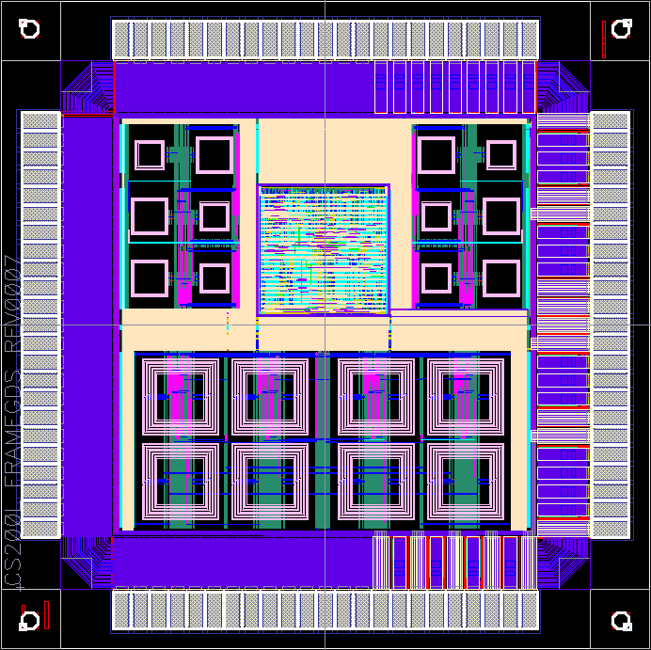
Test chip implementation @65nm
Three communication schemes can be tested
Ring network with VC flow control
Ring network with Bubble flow control
Vertical shared bus
Each chip has
Two cores (packet counter)
Two routers
Inductors for ring
Inductors for vertical bus
2.1mm x 2.1mm
Inductors (ring)
Core 0 & 1
Router 0 & 1
Process: Fujitsu 65nm (CS202SZ)
Voltage: 1.2V
System clock: 200MHz
Inductors (bus)

Slide 21
Test chip implementation @65nm
Three communication schemes can be tested
Ring network with VC flow control
Ring network with Bubble flow control
Vertical shared bus
2.1mm x 2.1mm
TX
RX
Inductors (ring)
Stacking for
Ring network
Core 0 & 1
Router 0 & 1
Inductors (bus)
Slide & stack

Slide 22
Test chip implementation @65nm
Three communication schemes can be tested
Ring network with VC flow control
Ring network with Bubble flow control
Vertical shared bus
2.1mm x 2.1mm
TX
RX
Inductors (ring)
Stacking for
Ring network
Core 0 & 1
TX/RX
Router 0 & 1
Stacking for
Vertical bus
Inductors (bus)

Slide 23
Evaluations: Simulation environments
Two network sizes are simulated by GEMS/Simics
3
7
2
1
1
0
0
CPU
L2$ banks
4 chips (4-CPU)
8 chips (8-CPU)
Table 1: Architectural parameters
Table 2: Software environments
# of chips | 4 / 8
# of CPUs | 4 / 8
# of routers | 8 / 16
# of L2$ banks | 16 / 32
Packet sizes | 1 or 5 flits
OS | Sun Solaris 9
Compiler | Sun Studio 12
Application | NAS Parallel Bench (OpenMP ver)
BT, CG, DC, EP, FT, IS, LU, MG, SP, UA (Total 10)
For more detail, refer the paper

Slide 24
Evaluations: Simulation environments
Two network sizes are simulated by GEMS/Simics
Three communication schemes are compared
3
7
2
1
1
0
0
CPU
L2$ banks
4 chips (4-CPU)
8 chips (8-CPU)
Dateline
2VC
Ring + VC flow
Ring + Bubble flow
Vertical bus

Slide 25
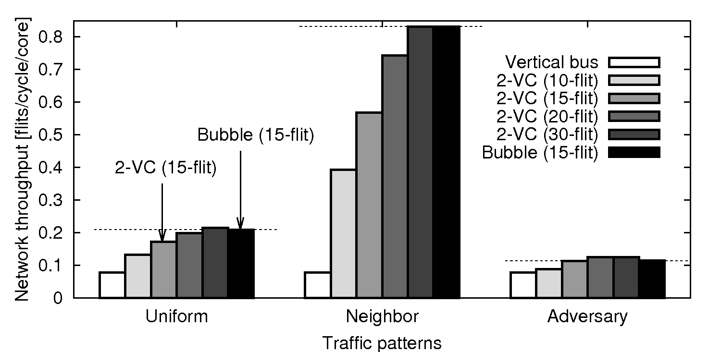
Results: Network throughput @ 4 chips
RTL simulations of wireless 3D NoC model (8 routers)
Ring + VC flow
2VC (15-flit)
Ring + Bubble
Bubble (15-flit)
Vertical bus
2VC(15-flit)
Bubble(15-flit)
Bubble outperforms 2VC(15-flit) & comparable to 2VC(30-flit)

Slide 26
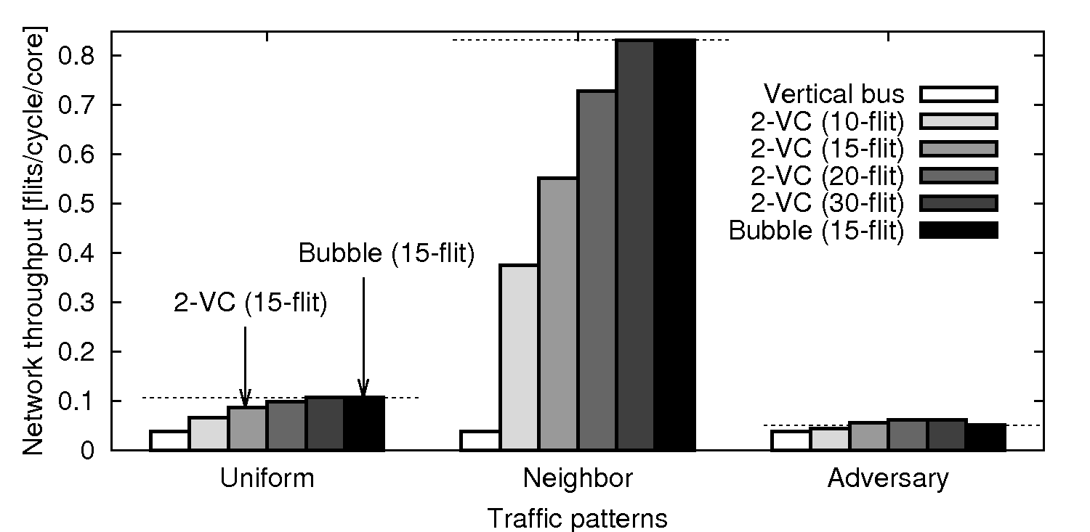
Results: Network throughput @ 8 chips
RTL simulations of wireless 3D NoC model (16 routers)
Ring + VC flow
2VC (15-flit)
Ring + Bubble
Bubble (15-flit)
Vertical bus
2VC(15-flit)
2VC(15-flit)
Bubble(15-flit)
Bubble(15-flit)
Bubble outperforms 2VC(15-flit) & comparable to 2VC(30-flit)

Slide 27
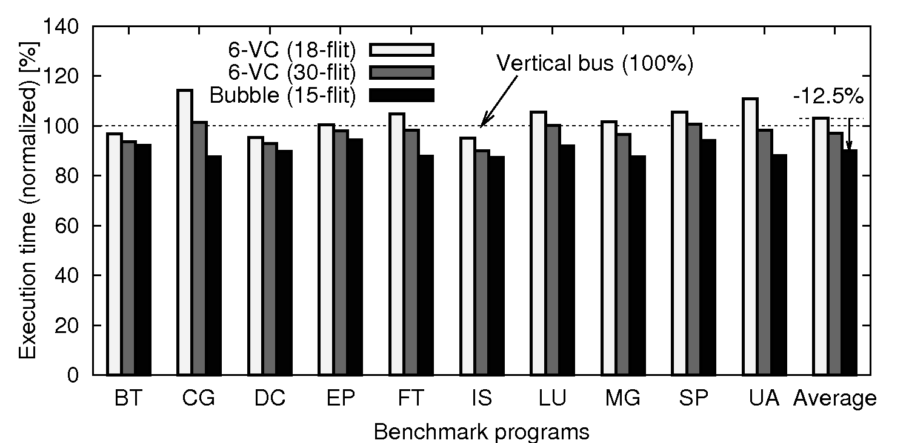
Results: Application performance @4chips
Execution times of NAS parallel bench (4 CPUs)
Ring + VC flow
6VC (18-flit)
Ring + VC flow
6VC (30-flit)
Ring + Bubble
Bubble (15-flit)
Vertical bus
-12.5%
Bubble approach outperforms VC-based one by 12.5% @4 chips

Slide 28
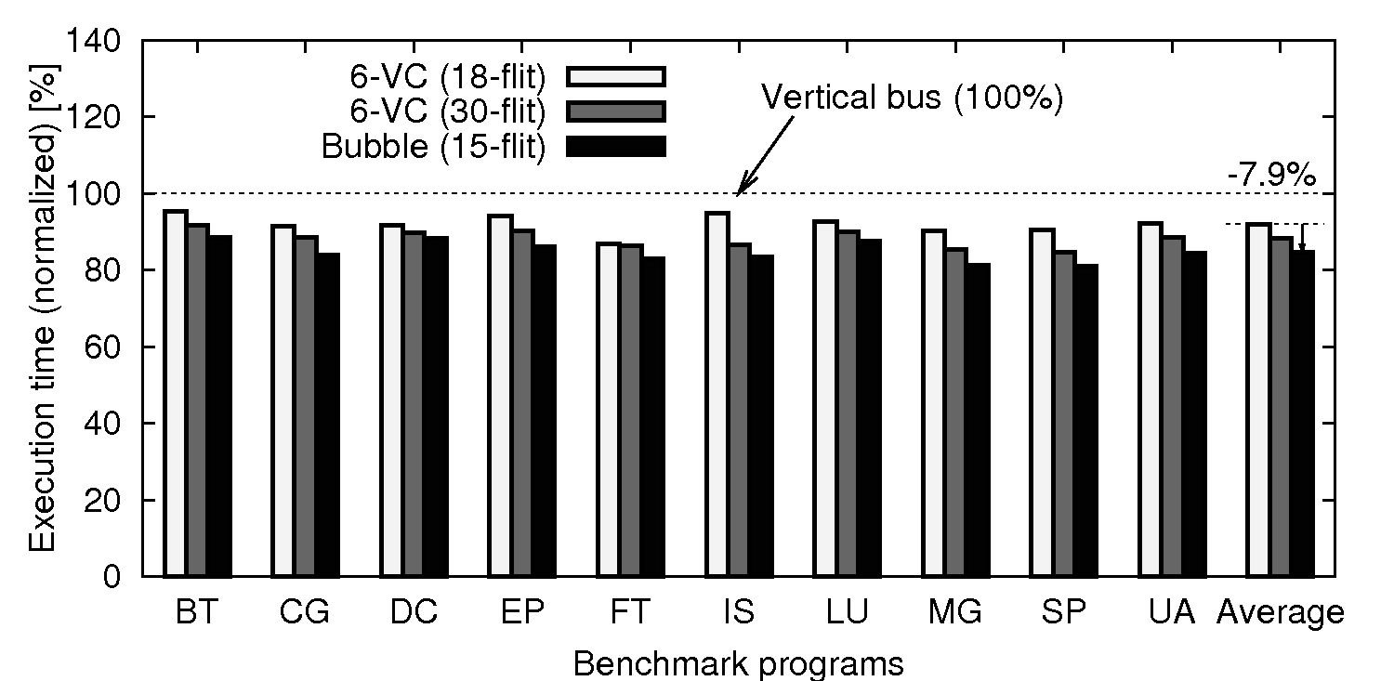
Results: Application performance @8chips
Execution times of NAS parallel bench (8 CPUs)
Ring + VC flow
6VC (18-flit)
Ring + VC flow
6VC (30-flit)
Ring + Bubble
Bubble (15-flit)
Vertical bus
-7.9%
Bubble approach outperforms VC-based one by 7.9% @8 chips

Slide 29
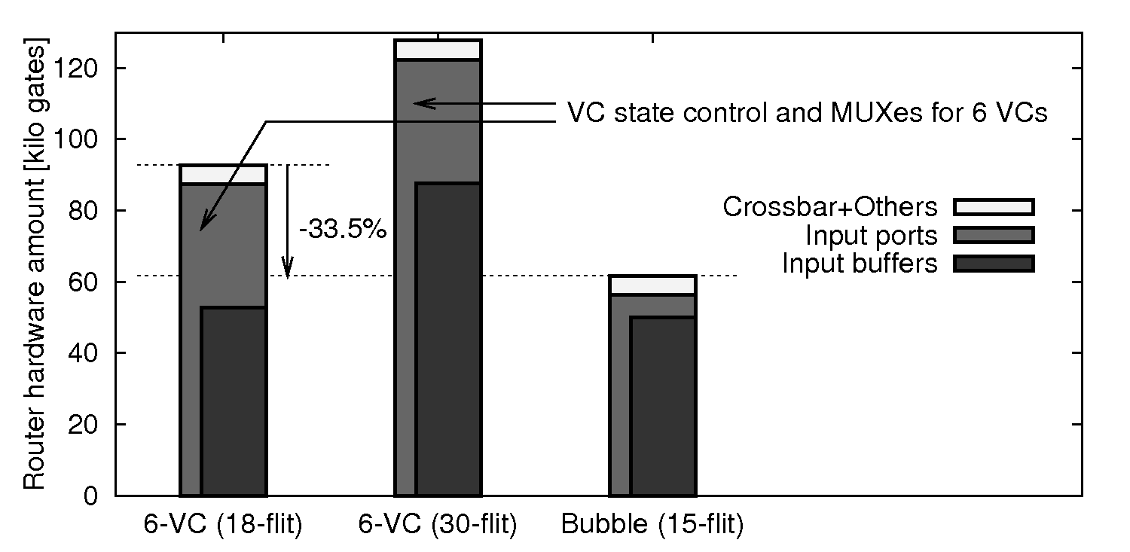
Results: Router hardware amount
Placed-and-routed 3-port routers for ring
6-VC (18-flit) : VC flow control; each VC has 3-flit buf
6-VC (30-flit) : VC flow control; each VC has 5-flit buf
Bubble (15-flit) : Bubble flow control; single 15-flit buf
-33.5%
Bubble(15-flit) router is smaller than 6VC(18-flit) by 33.5%

Slide 30
Summary: Wireless 3D NoC for CMPs
Our target: Wireless 3D CMPs
Type and number of chips stacked in package can be customized for given applications
Simple wireless 3D NoC for CMPs
Ring network with VC flow control
Ring network with Bubble flow control
Vertical shared bus
Experimental results
Real chip implementation
Bubble flow outperforms VC-based one by 7.9%-12.5%
Bubble router is smaller than VC-based one by 33.5%
Scalability issues remain → New approach with spanning trees

